Slide 1
FINMERGE Content & Strategy

Slide 2
Table Of Contents
Introduction - To Brand, Purpose, Objective
Selection of Medium - Channels of Marketing - Platforms - Social Media Game Plan and Objectives
Approach and Strategy - Defining the Target Audience - Content Strategy - Type of Content, tonality, dissemination

Slide 3
Introduction

Slide 4
Introduction
FINMERGE
We is a fin-tech brand which ha-s a mobile app through which it sells insurance and other financial products and helps bridge the gap between financial knowledge and its audience
PURPOSE
- To ensure the audience is financially literate
- To be the market leader in terms of educating people about financial products and help them manage their finances well and secure their future
OBJECTIVES
To educate and nurture its audience on their financial awareness
Lead them to buy insurance from our app by providing them the right content
Lead them to talk to our Tele sales rep or Financial advisor

Slide 5
Selection of Medium

Slide 6
Channels Of Marketing
Social Media
Identify the platforms, know the audience, device an online strategy, prepare content and engage with the audience and remarketing
Mobile App
Identify the mobile apps where from vendors like Clever Tap etc. where we can run in our video ads which lead to our app downloads
Email Marketing
Emailers to the existing customer base as well as new customer base from the form fills which we get from website contact forms upon due of premiums as well as whenever it is necessary
CSR/Community events
Giveaways in terms of CSR such as branded T-shirts or merchandise for the needy and getting a testimonials from the end audience, funding small community league sports and other events

Slide 7
Platforms of Engagement
Primary focus platforms
Awareness
Engagement
Secondary focus platforms
Traffic
Lead Generation
The chronological order of the platforms represent the relevancy of the platform for the corresponding ‘objective’
Platforms – FB, LI, TW, Instagram, YT, Whatsapp Business, SMS

Slide 8
Social Media Game Plan
Expand
Utilizing multiple social media platforms more efficiently
Using specific features of different social media platforms to reach out to more & more audience
Optimum utilization of integrated social media platforms
4
1
6
Content
Interesting content baskets
Sharable content
Providing Value
Giving out information
Being useful
Trends
Keeping finger on the pulse of the trends
Keeping our eyes open
Making most of any opportunity that comes up
2
7
Branding
Templatizing brand related posts
Adding brand elements to crafted posts
Consistency with logo, colors, fonts & graphics
Engage
Generate conversations
Stay involved in the conversations
Social Media Approach
8
Monitor
keeping overall strategy in line with the overall objectives
Monitoring all the activities on all the social platforms.
Keeping track of posts high level + detailed, Long term + daily
3
Tactic
Efficient mix of different content pieces
Posting regularly
Posting strategically
5
Interactive
Being fun
Being useful
Being interesting

Slide 9
Social Media Objective
Create awareness about our the brand amongst our target audience
Create, build and curate an online community for the brand through online channels
Trigger conversations & engagement on these channels, increase website traffic and build brand identity

Slide 10
Strategy & Approach

Slide 11
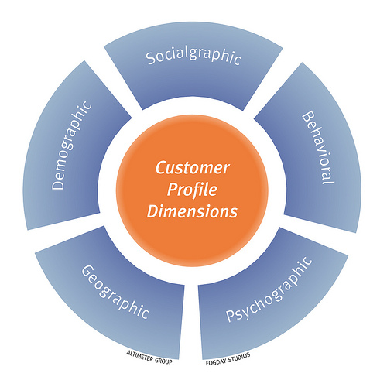
Defining The Target Audience
Likely target group from the age of 21 – 45+ - 21 to 35 years audience are consumers plus they create awareness as they engage with the content - 36 – 45+ are the ones who help brand grow and get potential referrals, business growth as well as new product buying as their pay package is on the higher side
Status - City and town dwellers with medium & high disposable income
Demographic & Geographic – Young, mid-aged, working as well as entrepreneurial professionals in the tier I and II cities
Behavioural traits – Mobile, Tech and Internet savvy, health conscious, lifestyle oriented, online shoppers, studying finance, or working in finance sector or dealing in stocks and other investments, etc.
Seniority – Executive, Freshers, Managers, Sales, HR and admin professionals of other companies, decision makers of small businesses, contractors, small enterprise owners etc.

Slide 12
Strategy to influence Email Open Rates
Good email open rates will depend on the following factors
Set the email campaigns only when it’s time for the customers to renew their policy or premium payment is nearby
The email subjects should be in bold and clearly stating that your premium is due or if any non-claim bonus is due
Change the domain every time a mailer is sent to the existing candidates so they don’t tank the domain reputation when they are irritated or moody
Tweak the subject to line and do A/B testing on the open rate last time and the current time, personalization can make a difference and also a little bit of role play For eg. Subject can say - Sheila can be your good .... (for men) Email body matter reads – Personal Financial Advisor Subject - A 50% flat off on... (for women) Email body matter reads – the latest child care plan can secure the future of your munchkin.
The subjects won’t be complete but it will surely create an intrigue and lead to good open rate

Slide 13
Emailer Approach
Email marketing campaigns can be carried out to target digitally evolved target audience
Target audience can be targeted by customized & strategically executed email campaigns
Why Create Emailers?
Better access. People may or may not be on social media during office hours, but they definitely check email
Emailer Topics
Introduction to the event (with link to website)
Emailer Database:
Existing database
Have seen the benefits of school management software?
Update about different offers
Embed infographics to the emailers
Other Database
49% emails are viewed on mobiles
Email has nearly three times as many user accounts as Facebook and Twitter combined
Checking email is the most important activity on smart phones for professionals

Slide 14
Emailer Approach
Initial Planning
Define Campaign Objectives
Content Strategy
Create wireframe
Tracking Logistics
Create tagged URLs
Describe Audience
Define Logistics
Draft Copy
Set Landing Page
Define Metrics
Request landing page
Create GA Goal
Content Creation
Create images/ Themes
Incorporate copy & links
Web Dev/ QA
Create & test landing page
populate the content
Review/ Launch
Review deliverables
Approve content
Upload email tool
Launch
Review/ improve
Analyze the results
Assess opportunities
Suggest Next steps
Send out emailers on relevant database.
Track open and response rate for mailers.
Analyze & optimize as per quality of leads.

Slide 15
Strategy to influence Web/Social Ad Open rate
On social media the ads completely get traction if the content is upfront and engaging
For eg – Interactive video just like the mobile ads for games on iOS and Android run in between other games it tempts us to still download a shitty game and play because in the ad the one who is playing is doing it wrong and we can’t just take losing in a game that is so easy so ultimately it leads to downloads same goes to our mobile app downloads
Another thing which intrigues a person to open a social media or web ad is to show something unusual like a hideous pimple on a person’s cheek and where the copy says he pops it out and you won’t imagine what comes out of it. Such click bait option are the only things which will work to get a person to open a Fin-tech company’s content ad
Another way is to let them open an ad is a prank or an easy quiz who everyone can answer but to answer they will have to see the ad

Slide 16
Content Views, Click Throughs, Leads
Content views
For content views the only thing which really works is boosting the content because am guessing our target audience is not the one who falls into a non working category who will be spending time on social media and until we push them to read something they won’t be spending money to buy a insurance Platforms – FB, LI, TW, Instagram, YT, Whatsapp Business, SMS
Click through’s to the content
Offers entice everyone be it a business looking out for expansion or a consumer looking out for groceries. In our case giving a money back SIP option or a part waiver to their next premium is the option to retain the customer and ensure the remarketing efforts are saved behind the existing customer which will increase the click through rate of our content
Leads generated from the content
Leads generated from a special platform or a piece of content which worked on that platform should be a benchmark and kept as a weapon in our Arsenal and be used from time to time whenever we are short on leads so as to help ROI
No of policies sold
Earning professionals (Our TG) always look for how they can get tax rebate or just with a minimum amount of payment how can they enjoy money double benefits which is why certain SIP options just like the LIC of India offers, should be introduced to keep the money coming in from the current customers. The amount of supporting SIPs sold towards a waiver for a next pending renewal of a policy should be counted as a policy sold and should be squared off

Slide 17
Content Themes & Duration
Content Themes - Below are a few things which will resonate with the core content themes/modules for Finmerge
Dreams – Talk about the dreams which our 3 category of TG might have - #InsureYourDreams
Care – Talk about what our 3 level TG cares - #CareAndShare
Stories – Share stories which our 3 modules of TG will relate to - #WeAreListening
Support – Be a partner in their joyful as well as sorrowful moments - #WeEmpathise
Duration Of Themes
The content buckets mentioned in the following slide are wider which helps sustenance for more than 3-6 months but the baskets can be bifurcated into a weekly dissemination Product, Finmerge, Generic, Health and wellness and Branding can be a weekly activity so that we don’t repeat content and have variety to talk about and Seasonal/Topical depends on the moment they happen or whatever and whenever its trending and this can run for a whole year long.

Slide 18
Content Baskets and Segregation Plan
These are the content modules around which content will be generated and shared on our digital platforms to generate conversations and engagement for our brand and to build a community.

Slide 19
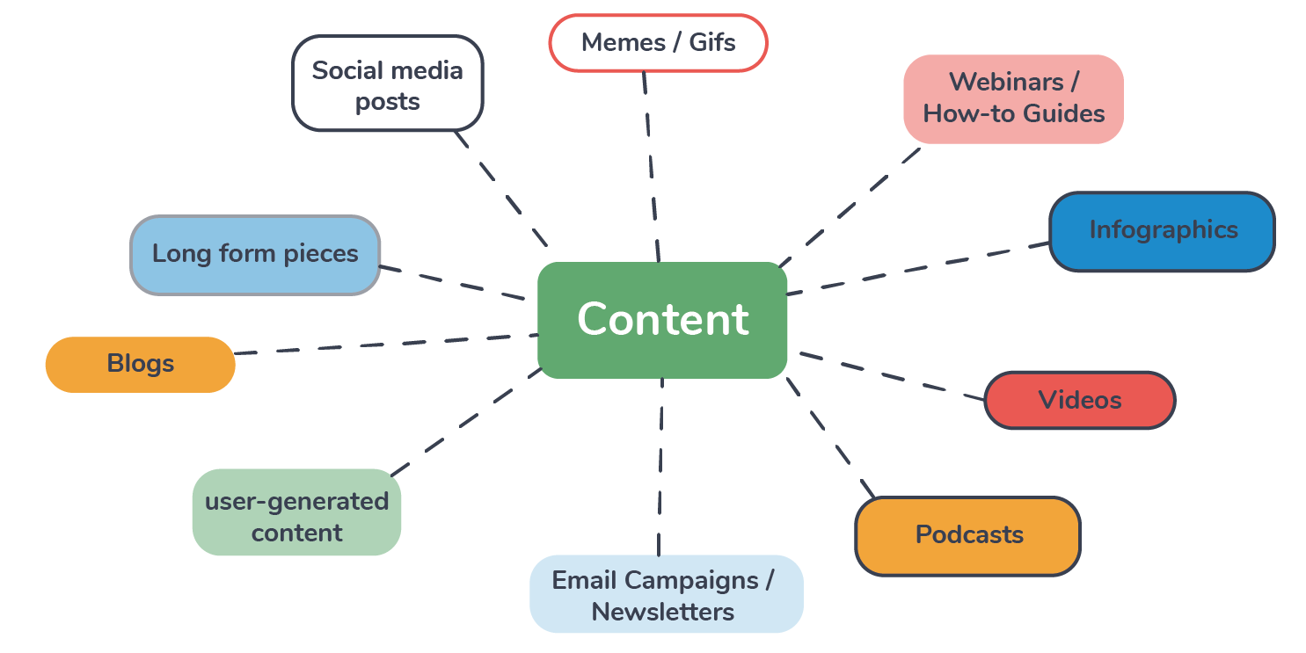
Content Type
Content Type - Below are some of the content types which can be used for this brand
Article – Not more than a minute read to make it consume better on small screen
Visual/graphic - Infographics / Short Video / Simple illustrations
Gifs – which tend to attract more engagement and can be screenshot if we want people to interact
Polls – Specifically on Linkedin or Twitter as it allows quick way to interact with the brand
Shared media – The posts which are share by other brands which may make sense to our audience
Slide share – Decks and/or reports which the brands may think fit to share with the audience
Carousel creatives – Specially on Linkedin, FB or Insta to make an impact
Status updates – On text only platforms like SMS, Whatsapp Business, Messenger can allow personalization
Emailer/Newsletter – An official email reminding of offers, plans, investments opportunities or season’s greetings
Webinars / E Awards/ QnAs – Series of online events where we give our Tg a forum to know better about our products

Slide 20
Content Tonality
Creating Your Brand Persona
CHARACTER
TONE
LANGUAGE
PURPOSE
- Friendly
Inspiring
Relatable
Professional
Compassionate
- Personal
Humble
Honest
Informative
Addressing
- Playful
Simple
Layman terms
Fun
Multi-lingual
Pun Intended
- Engage
Entertain
Educate
Inform
Solution Oriented
Subtly Salesy

Slide 21
Schedule of Content Dissemination
Content | Promotion | Channel | Reasoning
Article | Yes |  | TG tends to read the benefits
Visual Graphic | Yes |  | Videos tend to engage TG more
Slide Share | Yes |  | Informative and educating
Carousel Posts | Yes |  | It works like frames of information
Newsletters/Whitepaper | Yes |  | Because link generated content is generally promoted on these channels

Slide 22
THANK YOU

