Slide 1
Railofy Content & Strategy

Slide 2
Introduction

Slide 3
Introduction
Railofy
A tech firm which has made a significant breakthrough in the field of travel space in India by the use of Artificial Intelligence
PURPOSE
- To be the market leader in protecting all train travelers from one of the biggest problems in India, Railway (IRCTC) waitlist
OBJECTIVES
To educate and nurture the traveler audience to sign up with our protection against wait listing and RAC and secure their trip without letting them waste money on cancellations etc.

Slide 4
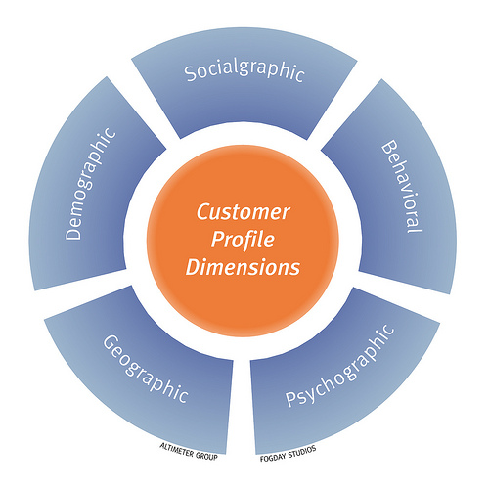
Defining The Target Audience
Likely target group from the age of 21 – 45+ - 21 to 35 years audience are consumers plus they create awareness as they engage with the content - 36 – 45+ are the ones who help brand grow and get potential referrals, business growth as well as new product buying as their pay package is on the higher side
Status - City and town dwellers with medium & high disposable income
Demographic & Geographic – Young, mid-aged, working as well as entrepreneurial professionals in the tier I and II cities
Behavioural traits – Mobile, Tech and Internet savvy, health conscious, lifestyle oriented, online shoppers, studying finance, or working in finance sector or dealing in stocks and other investments, travellers etc.
Seniority – Field workers, Executives, Freshers, Managers, Sales, HR and admin professionals of other companies, decision makers of small businesses, contractors, small enterprise owners etc.

Slide 5
Case Study Execution

Slide 6
Case Study 1
An average railway consumer transacts once in 3 months. Once we have got a potential customer to download the app, how will you engage the consumer to ensure that the railofy brand is on top of his mind till his next transaction occurs ? Share idea / strategy & not actual content briefly
Social Media
We keep these potential customer engaged through social media platforms by generating relatable content regularly and as the customer keeps getting reminded of protection the chances of transaction may increase
Mobile/OTT Apps
Our mobile app will regularly send notifications just like Swiggy/Myntra considering customer’s booking behavior and remind them of the protection plus SMS marketing & Whatsapp Business marketing to increase direct downloads which they need during travel
Email Marketing
Mailers to the existing customer base as well as new customer base where in protection offers will be sent out on their next travel booking will increase the chances of a transaction
Influencer Tie-ups
Influencers can play a huge role in letting people arrange their travel plans just like Ranbir and Alia did a campaign for Yatra.com we can get small time influencers whom people can relate with like BeYouNick or BhuvanBam
Strategic Alliance
Partnering with Ticket-booking apps like Paytm, GooglePay, RedBus.in or Goibibo etc. will give us the benefit of building an end revenue structure for the business model where in the protection can be won or be a package deal in these apps

Slide 7
Case Study 2
A particular railway customer has a waitlisted ticket with a date of journey 3 days from now. He feels that mostly his train ticket should get confirmed. Hence is not sure about buying Railofy’s protection. We want to target this consumer via app notifications. Please suggest an app notification for the same.
Push Notifications Sample Copy
TIER II Cities – For regular travellers like Surat – Mumbai or from Delhi - Mumbai
Kya aaj flight se jane ka mann hai? Railofy apka yeh sapna bhi pura karwa sakta hai.
Ratlam ke pohe se pet bhar gaya ho toh airport ka sandwich aur coffee jarur try karna kabhi. Apke kaise ka jawab hai – Railofy.
TIER I Cities – For people like Mumbai – Bangalore, Mumbai –Goa, Mumbai – Hyderabad etc.
We wouldn’t want you to miss your spicy Karjat Vada pav, but a Subway at Terminal 1 wont hurt either. Choice is yours!
Waitlist worry-free travel is your right. Claim it now!

Slide 8
Case Study 3
Please explain railofy to a new customer in a few lines. Assume the new customer is familiar with railways but has no idea about railofy.
Railofy is an insurance against IRCTC Waitlist & RAC
While booking a train ticket buy a Railofy protection
If your tickets get cancelled at the end moment
Railofy protection searches the best travel options for you
We make sure you reach your destination safely & quickly
Railofy wont let your waitlisted or cancelled tickets affect your travel
Either opt for a flight or a bus at the price of your train ticket

Slide 9
Case Study 4
Railofy wants to make a promotional video. Video will be released on social media channels & other possible avenues. Total budget is less than Rs 50K. Please share a concept (content idea) that you would propose for this video & how you would get the video executed ?
Concept Note
App Introduction with a third person reference (An animated video of Sudhir Mishra – A Regional Sales Manager @ XYZ )
We tell a story of a mid-aged man who is working at a company in a regional sales profile and whose job requires frequent travelling
He generally books tickets through online apps for interstate travel for his work purpose and then gets them reimbursed from his firm
He often faces real-time wait listing issues with his train travel bookings and faces cancellation charges which are often difficult to claim at his firm
His friend then suggests him to download Railofy and his benefits
Now he regularly books the railofy protection and has sometimes flown to other cities for work purpose on account of the cancellation of his waitlisted ticket
All thanks to railofy

Slide 10
Case Study 4
Railofy wants to make a promotional video. Video will be released on social media channels & other possible avenues. Total budget is less than Rs 50K. Please share a concept (content idea) that you would propose for this video & how you would get the video executed ?
Execution -
Posting as a native video on Facebook and Instagram and boosting the content for reach
In app mobile ad of this video through third party mobile advertising vendors such as clever tap on trending gaming as well as video chatting apps
Connecting with Instagram influencers to post the video from their handle
Doing a short YourStory or Business India article embedding the video on to their social media channels for more reach

Slide 11
Content Tonality
Creating Your Brand Persona
CHARACTER
TONE
LANGUAGE
PURPOSE
- Friendly
Inspiring
Relatable
Professional
Compassionate
- Personal
Humble
Honest
Informative
Addressing
- Playful
Simple
Layman terms
Fun
Multi-lingual
Pun Intended
- Engage
Entertain
Educate
Inform
Solution Oriented
Subtly Salesy

Slide 12
THANK YOU

