Slide 1
DIGITAL MARKETING PROPOSAL

Slide 2
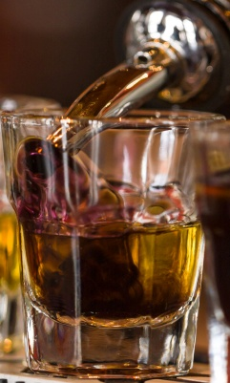
Approach & Strategy
Content Marketing
SEO, SEM & ORM
Introduction
Social Media
Ideas Of Engagement

Slide 3
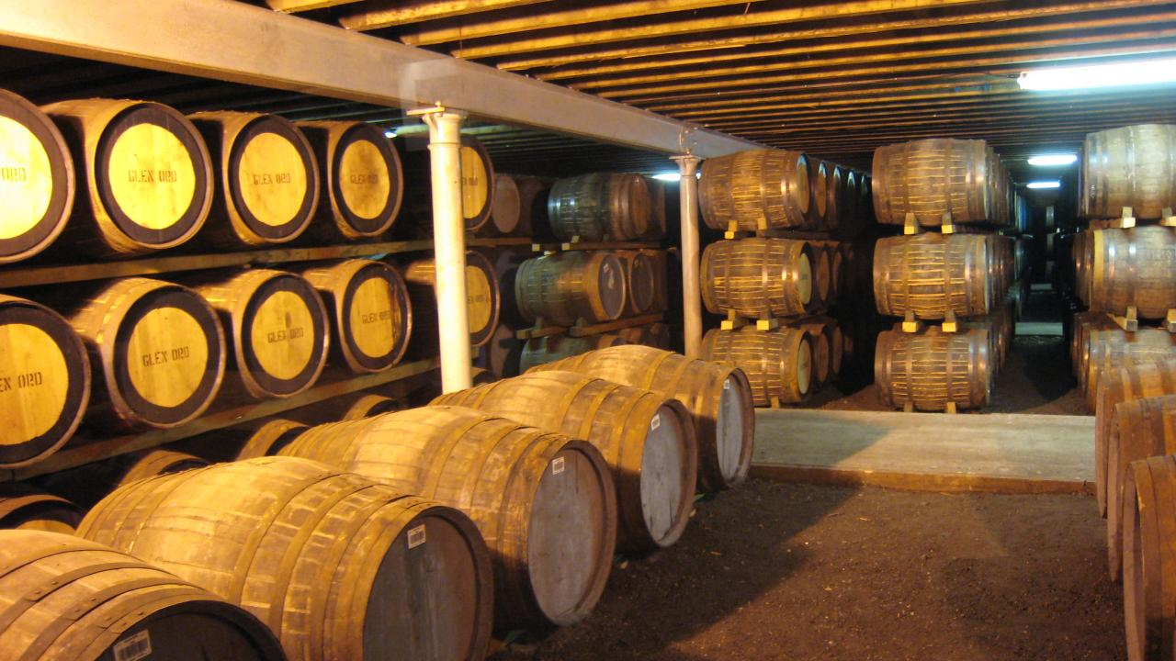
INTRODUCTION

Slide 4
An Award Winning Agency
2016
DMAi Echo Awards India 2014 - Gold
DMAi Echo Awards India 2014 - Silver
2015
DMAi Echo Awards India 2013 - Silver
DMAi Echo Awards International 2013

Slide 5
Why Ethinos?
Young & enthusiastic team
Achievers from diverse backgrounds
Technology Portfolio
Right from Guitarist, Drummer, Singer, Footballers to Engineers & MBAs
We shape ideas to yield results

Slide 6
Our Services
Strategy and Media Planning
Search and ORM
Social Media
Mobile and emerging media
Branding and design
Content services

Slide 7
APPROACH

Slide 8
Objectives
Create awareness about the brand amongst our target audience
Build an effective social media communication for our brand
Increasing the customer base & communicating to a larger group of audience on digital space

Slide 9
Ethinos Adapt Model
Audience
Identify the audience demographics, personality and their digital presence
Direction
Enlist the objectives, listen to the target audience and encourage interactions
Approach
Devise a strategy in line with the objectives, determine it’s scope and see if the strategy requires partnership with a firm or knowledge enterprise
Platforms
Tools
Identify the internet platforms where you can implement your strategy
Identify the tools for publishing, monitoring, engaging, cross platform management, campaign management and research

Slide 10
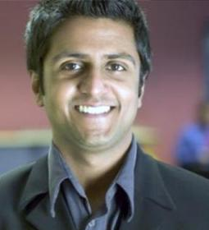
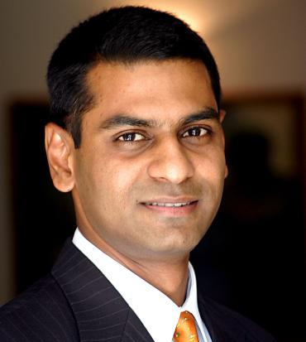
Target Audience Persona
Sudhir Iyer
Age - 25
IIT Bombay final year student
Works at an MNC as a Sr. HR & Admin
Active on social media platforms
Loves discounts and chilling with his buds on weekends
Rakesh Agarwal
Age - 28
MBA in HR from Welingkars
Works at YES Bank head office as a Sr. Marketing Manager
Heavy usage of mobile to access the internet
Organizes and attends corporate parties quite often
Anoop Singh
Age - 32
Diploma in Operations from Sp Jain College
With an experience of around 12 yrs works with Indiabulls finance as a Marketing and purchase head and highly mobile savvy and likes partying

Slide 11
Platforms (Scope of Activities)
Search Engine Marketing
SEM for searches that target all the four types of audience and the primary geographies
Social
Media
Social Media Management for organic growth and brand awareness, as well as advertising to reach a greater audience
Display and Banner Advertising
Display/banner ads on websites related to entertainment, lifestyle, gaming, technology, etc
Email
Marketing
Email marketing to drive registrations and subscriptions
Remarketing
Remarketing to ensure that the ads remain top of mind and increase the probability of conversion
Search Engine Optimization
Tata Genuine parts website should rank for keywords related to the services they provide

Slide 12
COMPETITIVE ANALYSIS

Slide 13
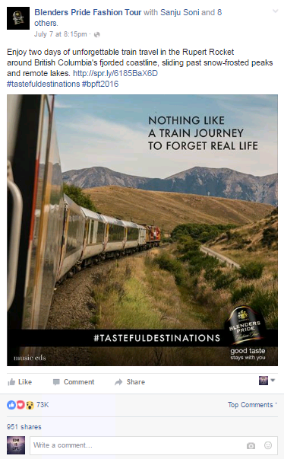
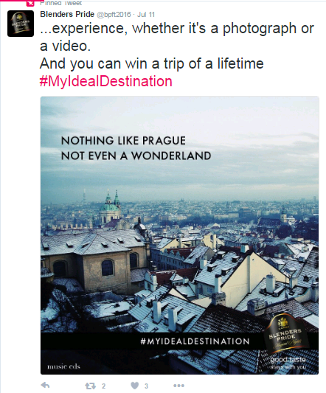
Blenders Pride Social Media
Campaign name - #Tasefuldestinations
Concept – Send us your tasteful travel destination photo or video and win a trip to Prague
Sentiment – Classy, Travel, leisure, relaxing and chilling
Likes – 73K, Shares – 951 and Comments 100+
Plaform – Twitter
Hashtag - #MyIdealDestination
Concept – same as #TastefulDestinations
RT – 3 Favs - 3

Slide 14
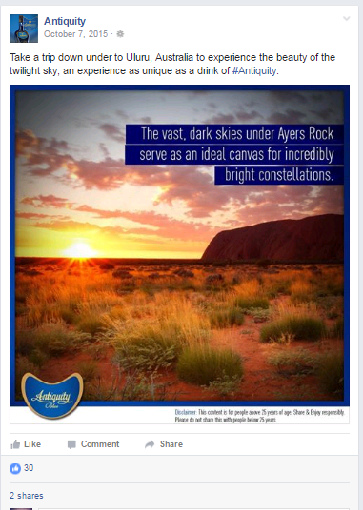
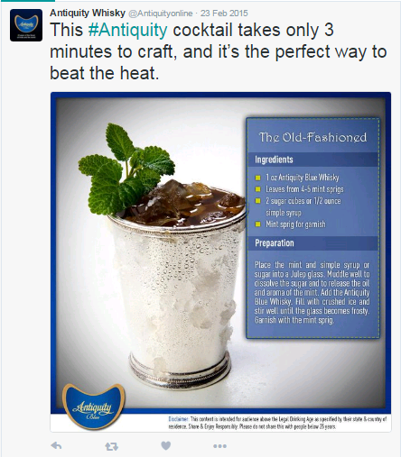
Antiquity Blue’s Social Media
This page is not active anymore
But their content was similar to what Blenders pride is doing currently
Rationale – Our competitors have taken the route of destinations to travel to and the whiskey to enjoy at those places
On twitter they shared a cocktail recipe using their product as an ingredient but it has no engagement

Slide 15
SOCIAL MEDIA

Slide 16
Social Media Game Plan
1
4
6
Content
Interesting content baskets
Sharable content
Providing Value
Giving out information
Being useful
Expand
Utilizing multiple social media platforms more efficiently
Using specific features of different social media platforms to reach out to more & more audience
Optimum utilization of integrated social media platforms
Trends
Keeping finger on the pulse of the trends
Keeping our eyes open
Making most of any opportunity that comes up
2
7
Branding
Templatizing brand related posts
Adding brand elements to crafted posts
Consistency with logo, colors, fonts & graphics
Engage
Generate conversations
Stay involved in the conversations
Social Media Approach
8
3
Monitor
keeping overall strategy in line with the overall objectives
Monitoring all the activities on all the social platforms.
Keeping track of posts high level + detailed, Long term + daily
Tactic
Efficient mix of different content pieces
Posting regularly
Posting strategically
5
Interactive
Being fun
Being useful
Being interesting

Slide 17
Social Media Platforms
Primary Platforms
Secondary Platforms

Slide 18
Social Platforms
Primary focus platforms
Awareness
Engagement
Secondary focus platforms
Traffic
Community Building
The chronological order of the platforms represent the relevancy of the platform for the corresponding ‘objective’

Slide 19
Sample Content Calendar For Repeat
Main Baskets (Objective Wise)
Repeat Content | Brand Awareness | External Content | Generic Content
Website articles | #HowItAll Started | Internal/External Events | Tips/Quiz
Blogs | Customer Testimonials | Offers and Discounts update | Puzzles/Questions
Guest bloggers | Contest Offers With Giveaways | #BoxOfHappiness | Topical Updates
Product Videos | Sustainability and CSR activities | DIY Repeat Cocktail Recipes | Occasion based & People Stories
The primary focus of the social media platforms will be to disseminate the website content and drive traffic to the website followed by the branding activities for the brand

Slide 20
Content Posting Plan
Weekly Content Calendar will be created
The execution plan can be demonstrated as follows:
Content Posting
Content from predefined content baskets
Content on special /current affair event
1
4
Seasonal/ theme based engagement activity
Short term contests
2
3

Slide 21
CONTENT MARKETING

Slide 22
Content Marketing Model
Understanding the audience persona
Themes and Topics for the content
Creation and
Design
Selection of channels for content dissemination
Measure and Evaluation of the ROI
Repurposing the content
Converting the strangers to your customers and then to your promoters
Content Marketing Model

Slide 23
Why Infographics?
Why Create Infographics?
Infographics drive 250% more traffic to websites than ordinary posts with pictures
Infographic Sharing Platforms:
Facebook
Infographics are 40 times more likely to get shared
On an average, Infographics get 832% more retweets
Twitter
Website
Infographic sharing websites like visual.ly,
As an add-on with press releases

Slide 24
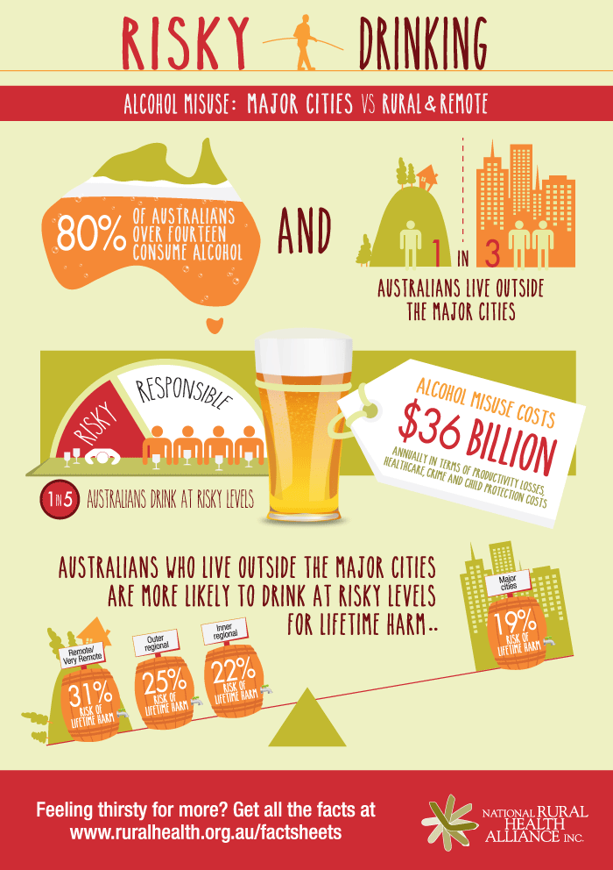
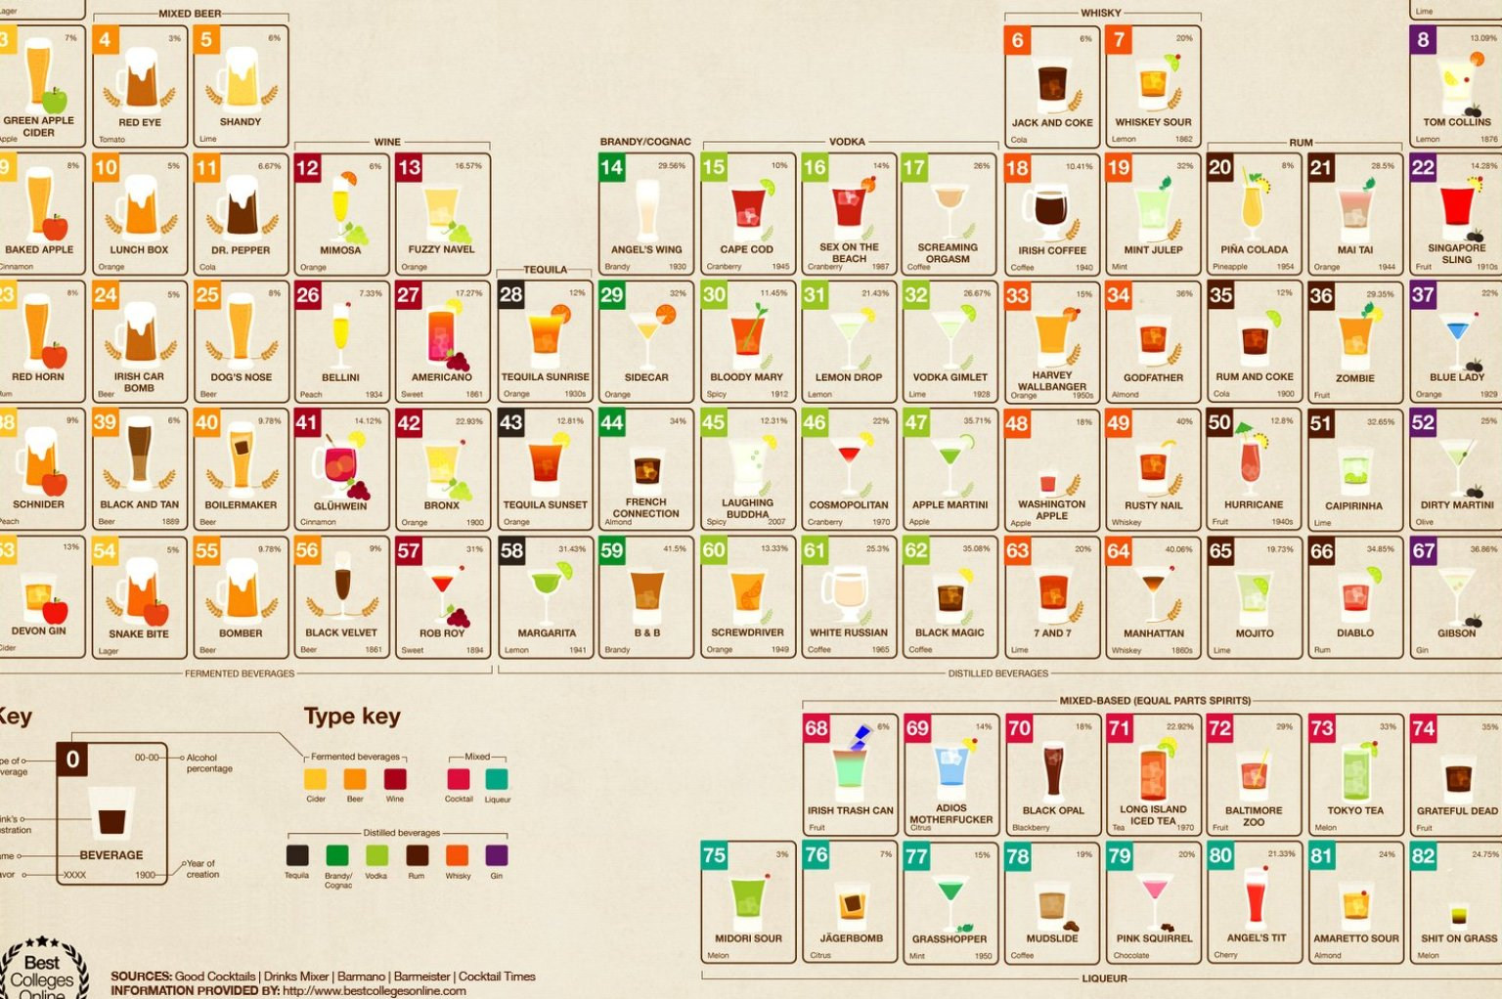
Sample Infographics

Slide 25
Weekly Repeat Newsletter
Weekly newsletter from Repeat Brand to the email id subscribers.
Newsletters to be customized as per the users interests and linking
The newsletter will also be mobile responsive in order to improve the customer experience
A part of the newsletter allows brand to publish their store content

Slide 26
Why Videos?
Why create videos?
74%
80%
46%
Increase in the understanding of a product after watching a video
Of the users remember the videos they watch online
Take action after viewing a video online
How does it help
Elaborate description of the product and service
It's easy to persuade people with video
They keep your audience interested
YouTube is the second largest search engine
Videos have the potential to go viral

Slide 27
Videos
Video series based on following themes
Branding video
Experiential videos
UGC
Videos which help the audience understand brand Repeat.
Highlighting the support staff. “Repeat Stories”
Funny CCTV footage
Showcasing the experience in the form of the videos
Audience testimonials
Covering the event on the video.
Behind the scenes
Customer Experiences and them enjoying the moments with our services
Focus on UGC in order to create authenticity
Dubsmash/Snapchat videos from our frequent users every Friday

Slide 28
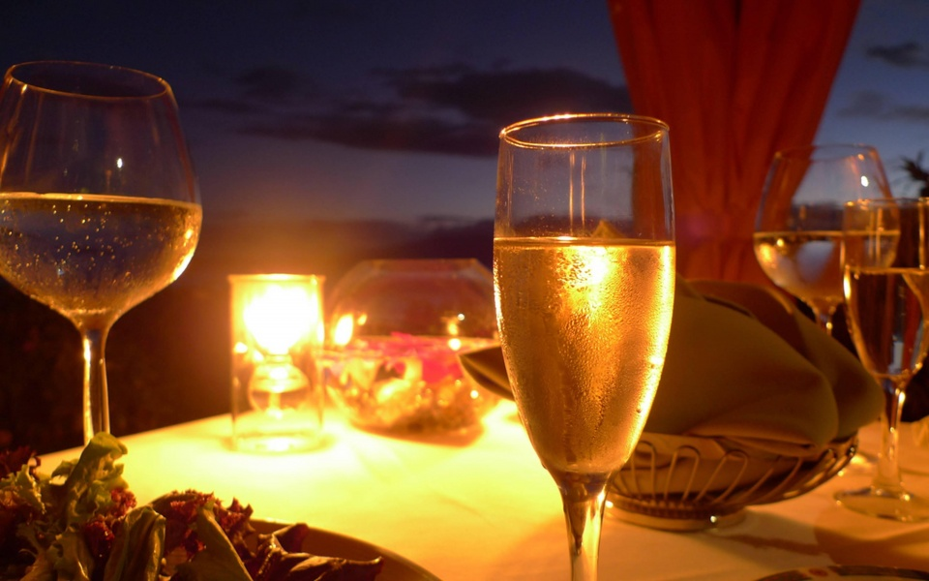
IDEAS OF ENGAGEMENT

Slide 29
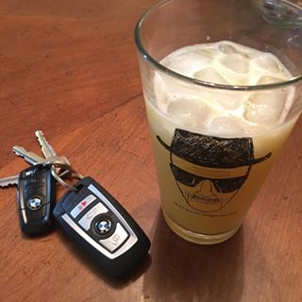
#DrinkDontDrive – Phase 1
A campaign on social awareness promoting Don't drink and drive
Simple posters and content around the topic as shown in the creative adjacent
Phase 1 of this campaign can be showcased through content from our brand pages as well as UGC’s
This will be basically to spread awareness about the brand and the social cause
#DrinkDontDrive

Slide 30
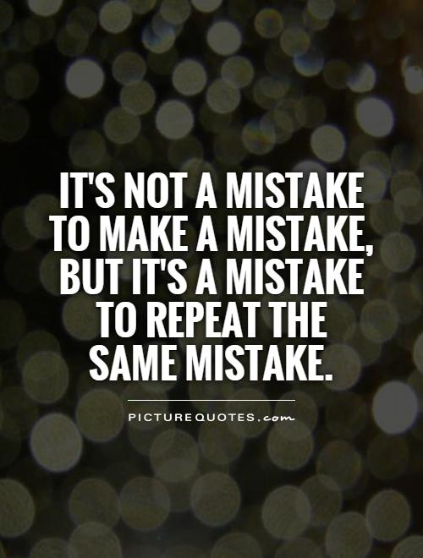
#DrinkDontDrive – Phase 2
In Phase 2 we can execute the same campaign through videos of youngsters who got caught in drink and drive cases, and their sad stories
We will reverse the tagline on digital saying Never Repeat Your Mistakes OR We take a pledge to never Repeat our mistakes
We can tie-up with cab services like UBER and OLA where their service is co-promoted with our campaign

Slide 31
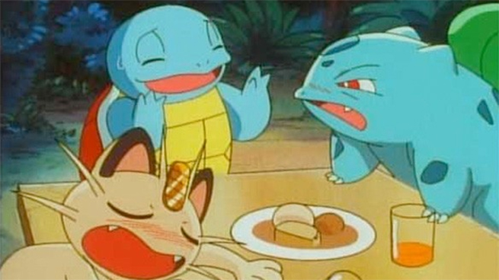
Socialize, Drink, Play Pokemon, Repeat
A campaign where we give people a chance to socialize and enjoy their drink and play simultaneously
We will ask people to send us a screen shot of a pokemon found by them at any bar along with a repeat bottle
As soon as they send us a screen shot we will send them a coupon code they can redeem at any bar for a free repeat drink
This gratification can be sent by a code or a sms
We will have to find a bars which are #PokeStop

Slide 32
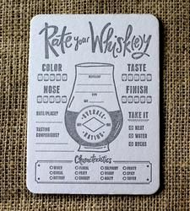
100 Good things that call for a Repeat
Purely for branding and recall purpose we can think of 100 moments or 100 treasured memories that would call for a repeat
We ask people to share their favourite or unforgettable stories of vacations, memories favourite tracks, random incidents etc which they would like to experience again
We share the best ones which we received and print them on Repeat coasters and gift ir to the ones who shared it
We can also execute this idea at a bar as an offline idea where we print the coasters then and there and gift it to our customer who buy our drink

Slide 33
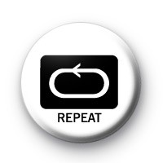
The Repeat Button
We will tie-up with a series of pubs and lounges for this campaign
Those will be called the lounge with a repeat button
There would be a buzzer on every table at our select bars and as soon as people press the repeat button on a particular song the DJ gets a track that how many repeats has he got for that song and he then decides whether to repeat the track or no
We have another connect to this which is related to music which is the primary interest of the young crowd contd. in the next slide

Slide 34
The Repeat Playlist
We create a customised playlist on sound cloud or mixcloud
A weekly repeat podcast on this channel that will be an hour long from Repeat’s end
This will feature some of the freshest/hippest new tracks from across genres
The idea is to promote the playlist as something people can listen to at home for their house party or probably while on their way out
Giving a chance to aspiring DJ’s for producing the Repeat set of the week for users to listen to
THE
Playlist

Slide 35
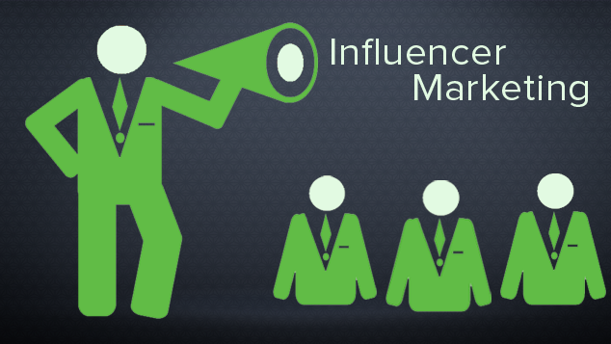
Influencer Outreach
We use influencers and lifestyle bloggers on Instagram for promoting our product subtly
The list of bloggers/influencers will change their DP or put a pic from their official account showing a repeat bottle and a glass in the foreground
This would help indirectly promote our brand with a subtle approach in terms of showcasing the choice of these influencers
Would also help with living up to repeats claim of being a fine grain single malted blended with Indian spirits and chosen by influential people

Slide 36
SEO

Slide 37
SEO Integrated Approach
Website
Social Media
The approach for SEO will integrate all channels – Website, Social Media, Collateral and PR – to deliver optimum results by driving more traffic to the website
The Game plan for SEO will be split into two:
High volume keywords – which will drive larger amount of traffic from search over time
Low volume but focused keywords – Some keywords might have low monthly searches but will be highly relevant and would have a greater possibility to generate highly relevant leads
Search Engine Optimization
Collateral
PR

Slide 38
SEO Process
Understanding
Client’s Requirements
Understanding Target Audiences
Define Objective
And
Goal Setting
Strategy
and
Planning
Analysis
and
Reporting
Monitoring and
Evaluation
Implementation

Slide 39
SEM

Slide 40
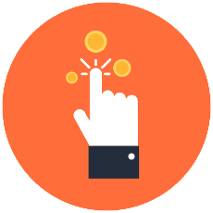
SEM Campaign – The Process
Keyword Research
Optimization
Analysis & Reporting
Ad Creation
1
9
2
Optimization
Campaign Assessment
8
3
Landing Page Development
7
PPC
4
Monitor
Account Setup
6
5
Campaign Launch
Tracking Pixel Installation & Testing

Slide 41
Campaign Approach
Test Campaign with lower spends
Duration : 25 - 30 days
Analyze the performance of the test campaign and modify the strategy as per the analysis
Allocate budget as per the trends seen for the particular product
Optimize the campaign in order to maximize the ROI

Slide 42
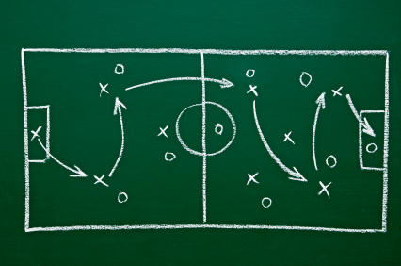
SEM Ads Game Plan
The game plan for SEM would be selected on priority taking two factors into consideration like :
Monthly search volumes
The higher the monthly search volume, the greater the number of times the ad will be displayed and the greater the traffic which will be driven to a website with that keyword
Search ads competition on the keyword
The lesser the competition on a particular keyword, the greater the chance that we will be able to deliver ads at a lower CPC and a higher CTR
Ads with high keyword density
Higher the occurrence of the keyword in the ad copy combined with a good landing page will ensure better conversions & lower CPC
Linking Adwords with analytics
This will enable us to optimize the campaign on a keyword level by assessing bounce rate & other metrics related to keywords & also optimizing the campaign to show ads for the ad position that gives the best performance
Automation of the account
We would be using the inbuilt automation tools(for bid management etc) from the adwords interface to get optimum results

Slide 43
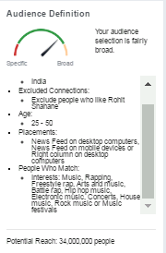
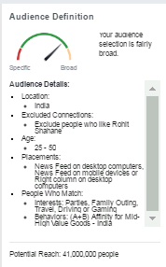
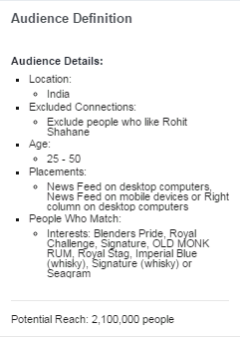
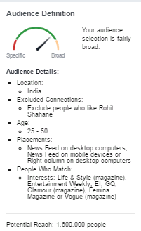
Sample Facebook & Instagram targeting
Theme – Music Genres
Theme – Youth Interests
Theme – Competitors
Theme – Lifestyle Magazines

Slide 44
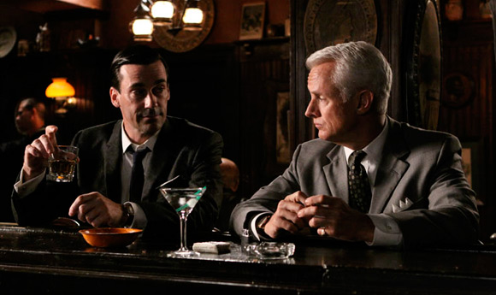
ORM

Slide 45
Platforms to be looked at for ORM
Online reputation management
Blog posts
Forums
Review sites
Social media sites
Press releases

Slide 46
ORM : Process for responding to negative reviews
Online reputation management process (Responding to negative reviews):
Analyze the situation. Does the negative review have any merit?
If Yes
Offer to discuss and sort out the issues being faced.
Use real brand names while replying and provide means for the customer to contact in a quick way.
If No
Provide facts and ask for corrections

Slide 47
ORM Monitoring Baskets
Themes | Search Method | Source
Institutional Content | Keyword Based | News | PR | Company Blogs | Twitter
Individual Content | Keyword Based | Facebook | Twitter | Personal Blogs | Forums | Complain and Petition
Influencer Content | Source based | Individual Profiles - Twitter | Blogs
Competition and allied content | Source Based | Official Blog | Facebook Page | Official Twitter Profiles
Business and Industry content | Keyword Based | World Wide Web

Slide 48
ORM Monitoring Baskets
Identifying the keywords where negative reviews are prominent
Create positive content/reviews and optimize them to appear above the negative reviews
Create an identity hub by linking all the content to one place.
Notes:
For the identity hub, we would claim a domain name ideally including a search term to let the search engines know what the page is about.
Link all the positive reviews to the site, making the optimized hub a place for people online to see the positive side of the brand offerings.
Link social media feeds to the page since search engines love fresh content.

Slide 49
Escalation Procedure
MENTIONS
Brand Keywords
Brand + Product keywords
& others
-
Manual Curation of all Mentions
Negative comments
To be escalated to the Indofil Team
Recommendations to be provided with the response that’s applicable to the comment
Will be archived
DAILY | WEEKLY | MONTHLY
Manual Classification
+
-
+
~
~
1. By SENTIMENT
2. By THEME
ANALYSIS & REPORTING*
Volume | Theme | Trends | XX | YY |

Slide 50
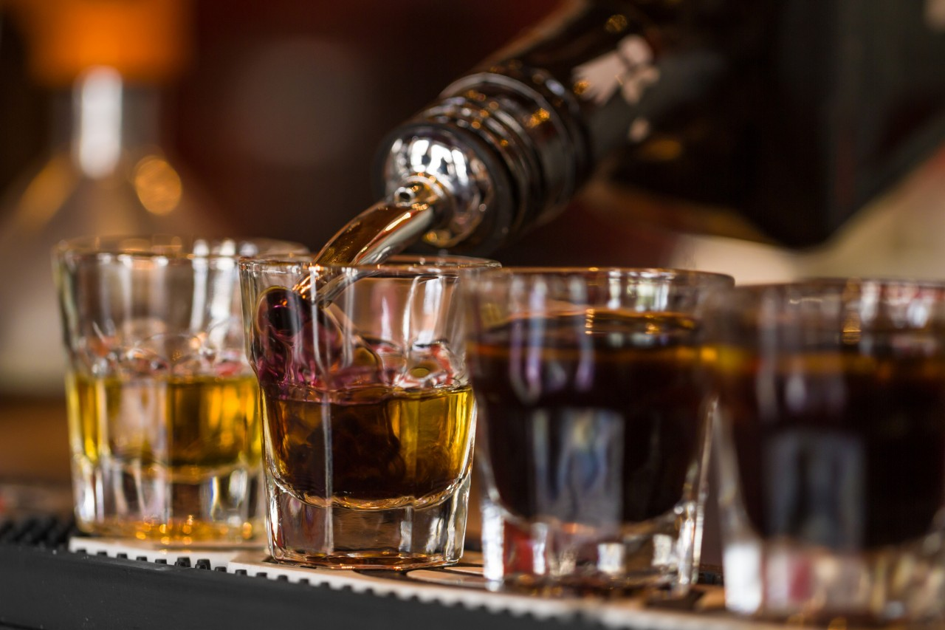
Metrics

Slide 51
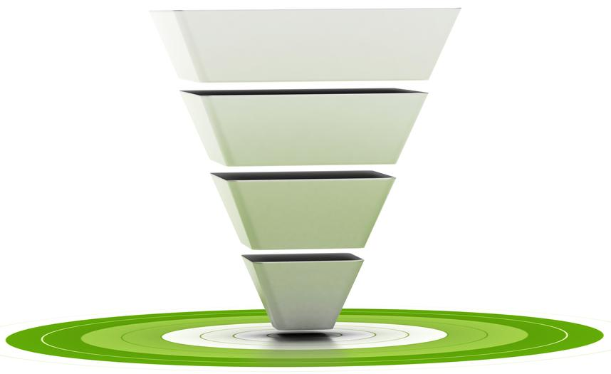
Metrics
Paid
Organic
Impressions, Reach, views, page likes, followers
Exposure
Impressions, Reach, views, page likes, followers
Interactions
Likes, Comments, Shares, Favorites, Retweets, Replies, Reviews, Followers
Clicks, Mouse roll overs, comments, Image clicks
Actions
Website traffic through social & SEO, Number of forms submitted through social media, App, Websites, App downloads, Referrals
Number of forms submitted through paid ads, CTRs, CPC, bounce rate, CPA
Conversions
Number of leads generated through Paid media, app, website, emails etc.
Number of leads generated through social media, app, website, emails etc.

Slide 52
Contact Us : Siddharth Hegde
siddharth.hegde@ethinos.com +91 98202 17252

