Slide 1


Marketing Plan
June 2018
Notes:
TITLE SLIDE

Slide 2
Proposed Positioning
As is
To be
A leading global Messaging and Voice API company, leading in terms of value offered, customer service, talent development and consistent growth
A leading global Cloud Communications company connecting the world through latest technologies on multi channel platforms; delivering superior customer experiences globally and locally. (GLOCALLY)

Slide 3






Offerings
Route Mobile
ENTERPRISE & OTT
OPERATOR
BPO
WHOLESALE / RESELLER
Voice Outsourcing
Wholesale Voice
Messaging
Voice
Email
SMS Filtering, Analytics & Monetization
Wholesale SMS
A2P
OBD
R. Mailer
R Shield (365sq)
2Way
IVR
Num Lookup
R. Hub
Acculync
Missed Call
R. Connector
Click2Call
R. OTP
Machine Learning, Artificial Intelligence
Analytics

Slide 4
Broad Focus
Become industry influencer
Sustain its
presence
Strengthen the brand
3-5 Years Roadmap

Slide 5



Structured Approach
Approach
Company Branding
Products /
Services
Next Gen Technologies

Slide 6
Increase brand awareness through..
1
2
3
Focused and targeted marketing activities
Curating content & using thought leadership articles
To capture the mindshare of the target audience

Slide 7
Focus on Targeted Activities
Effectiveness in Influencing Purchase Decisions
Phase 1: Determining Solutions
Phase 2: Identifying Providers
Phase 3: Selecting Providers
Strategic brand association by collaborating with industry events and thought leadership content
Re-define go-to-market messages in key business publications
Niche Telecom Trade & Online Publications to create better brand presence
Targeted
Branding

Slide 8










To significantly increase brand awareness
Events
Business Publications
Trade Publications
Online Publications
Sample list
Sample list
Sample list
Sample list
Listing

Slide 9
With Thought Leadership Initiatives
Strategy:
  Position Route Mobile on credible platforms
  Co-branding and association with trade publications to release high-impact whitepapers
  Areas chosen are Route Mobile sweet-spots and business focus – Messaging, voice, firewall with a messaging wrapper of ML, IOT, AI leading to cloud computing
  Messaging reflects our branding, positioning and key differentiators
Support: Product team, Operations team participation in quality and quantity of thought leadership support

Slide 10




Along with Relevant Content
Focus on building thought leadership assets in-house
  Creation of a thought leadership edit calendar for every business unit (based on market-focused, industry trends, business focus, capabilities, new products)

Slide 11
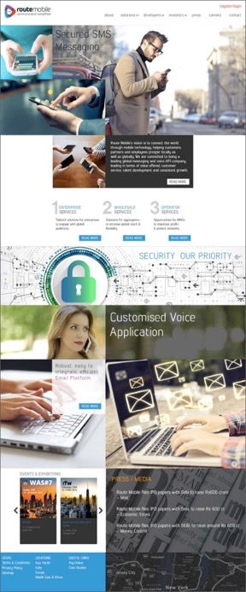
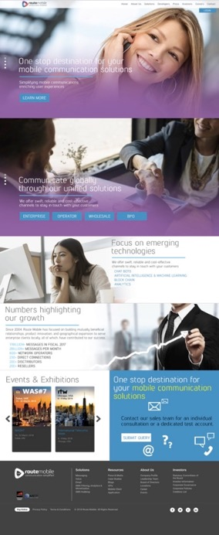
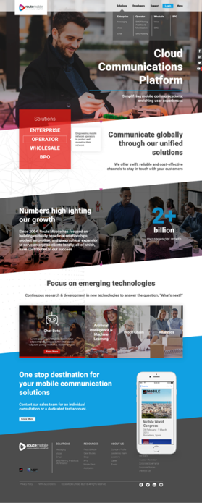
Renewing touch points - Website

Slide 12
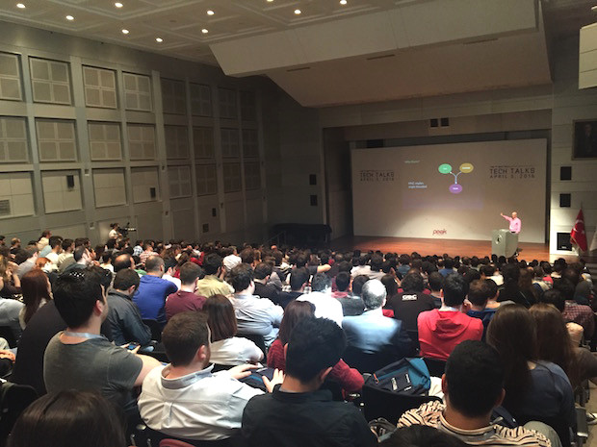
Creating new communities
Target developers in the IT and Telecom space to drive more engagement
Approach:
  Developer Website
  Route Mobile Developer Meet 2019

Slide 13
Structure
Marketing
PR & Corp Com
Events & Merchandise
Social Media
Content
Design & Creative
Developers Engagement

Slide 14

Corporate Communications

Slide 15
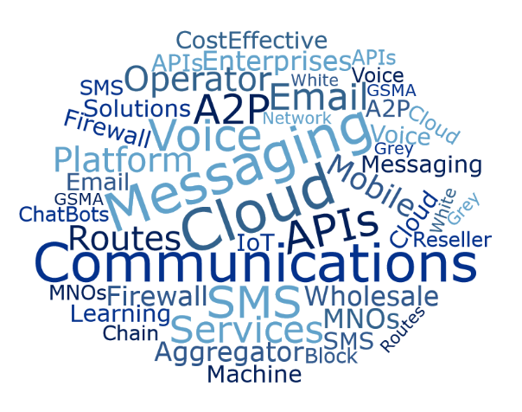
Corporate Communications
What are we trying to accomplish?
  To make Route Mobile more visible in IT and Telecom media space
  To promote the product portfolio on media forums / channels
  To iterate Route Mobile as one of the leading global players in the cloud communications platform services in all key messages
  To position the brand spokesperson as industry thought leaders
Targeted Keywords

Slide 16
Approach
ROUTE MOBILE LIMITED
Brand / Corporate
Product
New Technologies
Company / brand profiling – Talk about journey & strategy
Spokesperson Profiling – Position them as industry leaders
Corporate Announcements - Initial Public Offering, Network expansions
Highlight specialised solutions – Messaging, Voice, Email & SMS Filtering, Analytics and Monetisation
New Product launches
Media FAMs – participations in trade / industry events
Foray into new technologies Artificial Intelligence Block Chain Machine Learning Chat Bots

Slide 17
Desired Messaging
Brand / Corporate
Route Mobile is the leading player in cloud communication platform services with diversified offerings Has a global connectivity through established relationships with MNOs Has a diversified and global client base across industries serviced locally Aim is to connect the world through mobile technology & enriching customer experiences Route Mobile is going public as the part of its long term strategy Will grow presence in additional markets to serve clients locally
Product
Route Mobile offer range of services in messaging, voice, email and SMS filtering, analytics and monetization Delivers network agnostic services: partner with more than 850 network operators in 5 continents. More than 230 direct connections Offers exceptional value marketing and communications programmes 24-7 service centre to support customers Consultative approach – regulation compliant communications globally Faster set up and deployment
New Technologies
We are focusing our research and development efforts on the integration of our communications platform with new technologies We intend lay more emphasis on developing communication solutions through artificial intelligence (“AI”), machine learning (“ML”) and block chain for advanced data analytics and predictive analysis.

Slide 18
Approach
ONE-ON-ONE INTERACTIONS
PRESS RELEASE
1 – 2 media interactions / per month
Target Media: IT & Telecom trade, Financials, Mainline, Online Media, Business Magazines
Themes: Company profiling, RML Journey and way forward strategies, New technologies and their future, Benefits of RML product & services
As per product and corporate announcements
Target Media: IT & Telecom trade, Financials, Mainline, Online Media, Business Magazines
Themes: Product launches, new acquisitions & deals, IPO, new offices, senior management hiring
RELATIONSHIP BUILDING MEETINGS
AUTHORED ARTICLES
1 – 2 media meetings / per month / regions
Target Media: IT & telecom trade, financials, mainline, online media, business magazines
Themes: Company profiling, RML journey and way forward strategies, new technologies and their future, benefits of RML product & services
Tactical / 1 in 2 months
Target Media: IT & telecom trade, financials, mainline, online media, business magazines
Themes: Topics on messaging, voice, email, firewall, new technologies, industry and trends
Media Familiarisation Trip - 1/2 journalists – Trade and Business Publications
Onsite event engagement – MWC Americas, WAS#8, MWC Barcelona

Slide 19
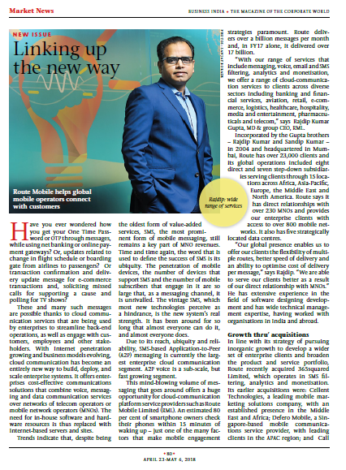
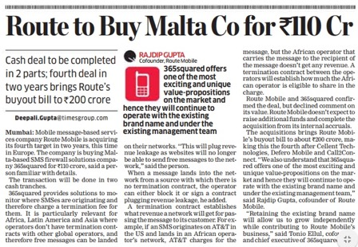
What we can achieve..?
Build organic reach of the brand on search engine platforms
Credible content increases the brand value
Get more value media space at no-cost
With just 2 articles worth
INR 8,98,000 of the ad-space

Slide 20
Content
Website & Social Media forums – Populate content on these platforms to drive engagement
BLOGS
3-5 blogs every month – website & LinkedIn
CASE STUDIES
Revise and add new branded case studies
INFOGRAPHICS
Presenting product literature differently
VIDEOS
Product videos on website & social media platforms
EVENTS
Regular updates, spokesperson bytes, booth visits etc.
NEWSLETTERS
Monthly / Quarterly updates on events & corporate announcements

Slide 21

Digital Plan

Slide 22












Social Media Objectives
Primary focus platforms
Awareness
Engagement
Secondary focus platforms
Traffic
Community Building
The chronological order of the platforms represent the relevancy of the platform for the corresponding ‘objective’

Slide 23
Current Scenario of Online Channels
Month | Facebook (Likes) | Twitter (Followers) | LinkedIn (Followers) | Nature of Followers
Sep 2017 | 733 | 102 | 5514 | Organic
Mar 2018 | 957 | 153 | 7317 | Organic
% Growth | 31% | 50% | 33% | Organic
The actual % numbers have seen an increase over the period of 6 months from Sep 17 – Mar 18
We would maintain or slightly increase the online channel fan base incorporating the revised content baskets, additional online & offline activities and increase brand recall organically

Slide 24
Current Content Modules
EVENTS
  Live event Updates
  Profiling & Build Up
PRODUCT
  Product Related promotional updates
  Product Videos
RML INTERNAL
  RML Hiring, Internal Events
  #LifeAtRML
INDUSTRY
  #FridayFacts
  Industry related articles

Slide 25
Competitor Analysis
Name | Facebook | Twitter | LinkedIn | YouTube | Avg. No of Updates weekly | Nature of Updates | Update Type | Weightage | Average Engagement
RML | 961 | 153 | 7312 | 0 | 5 | External links, Events, Facts, RML Internal activities, RML contact Us, Hiring, Case Studies, Product, Interviews | Branded | Events, Product, External articles | 10.3
Infobip | 18318 | 3682 | 19209 | 252 | 8 | External Links, Events, Website blogs, Press Releases, Events updates, Videos, Case Studies, Internal Activities, | Non Branded regular updates | Infobip website Blogs, External Links, Press Release, Case Studies | 20.1
Twilio | 39825 | 64112 | 25798 | 19933 | 7 | External Links, Events, Website blogs, Press Releases, Events updates, Videos, Case Studies, Internal Activities, | Non Branded Regular Updates | Twilio website Blogs & External Links | 8.1
Nexmo | 17411 | 4047 | 5810 | 305 | 5 | External Links, Events, Website Blogs, | Non Branded Regular Updates | Nexmo website blogs & external links | 2.8
Knowlarity | 58163 | 3662 | 7242 | 205 | 3 | External Links, Topical, Internal Events, Fun at Work | Non Branded | External Links & Internal Activities | 7.6

Slide 26
Proposed Content Baskets (high level)
Business
(Co. + Owners)
Products
(New + Old)
New Innovation and technology
Route Mobile Company
Achievements & recognition in the industry Media articles
Press Release Articles
Infographics
RML Website Blogs about Products/Company Events etc.
Aiding Efficiency/ Productivity/Brand Awareness
How are we helping a large base of potential and existing customers
Case Studies Branded/Unbranded content
Online Presence of the brand/brand awareness
Quotes & Thoughts by Owners/co-founders, CEO's COO's & influential people
Thought leadership
Product/Service Related
Product / Features/ Working/ Videos
USP's
Product Showcase at events
Community Engagement
Trending Updates
Community Events / Developer meets
Offline activations / Global activities
UGC/ Engagement Based
Events
Live Updates & profiling
Nominations/ Awards For different Categories
Calendar Events Build up / Promotion
Video/ Event videos
In house activities / #LifeAtRML
New Innovation & Technologies
Innovations in Industry
Industry web links
New product enhancements helping communications industry

Slide 27
Proposed Module-wise Content Deployment Plan
On Going
Additional
Events
PR
  Event participation
  Media interactions, interviews
  Event Creation | Build Up/Intro | Profiling | Live Updates
  Product Showcase
Products
  Product promotional updates | Videos
  Product Road Map Monthly updates
Innovations & Technology
  External and internal articles of product enhancements & industry news
RML Internal
  RML Hiring | Internal Events | #LifeAtRML
  Info-graphics | Website blogs
Blogs
  Industry, event, products and topical blogs

Slide 28
Suggested approach to increase relevant followers
Identifying the platforms (LinkedIn & Twitter)
Identifying the Industry influencers /Guest bloggers
Follow, Share & create content matching the influencers / market interest
These influencers share our content in turn cross promoting it
In turn we attract relevant followers
This new audience follows us for market related content
We indirectly target new audience who are interested in our content

Slide 29
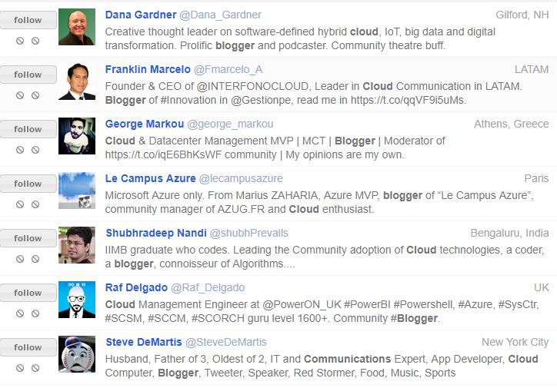
Sample Influencer/Guest Blogger Profiles

Slide 30
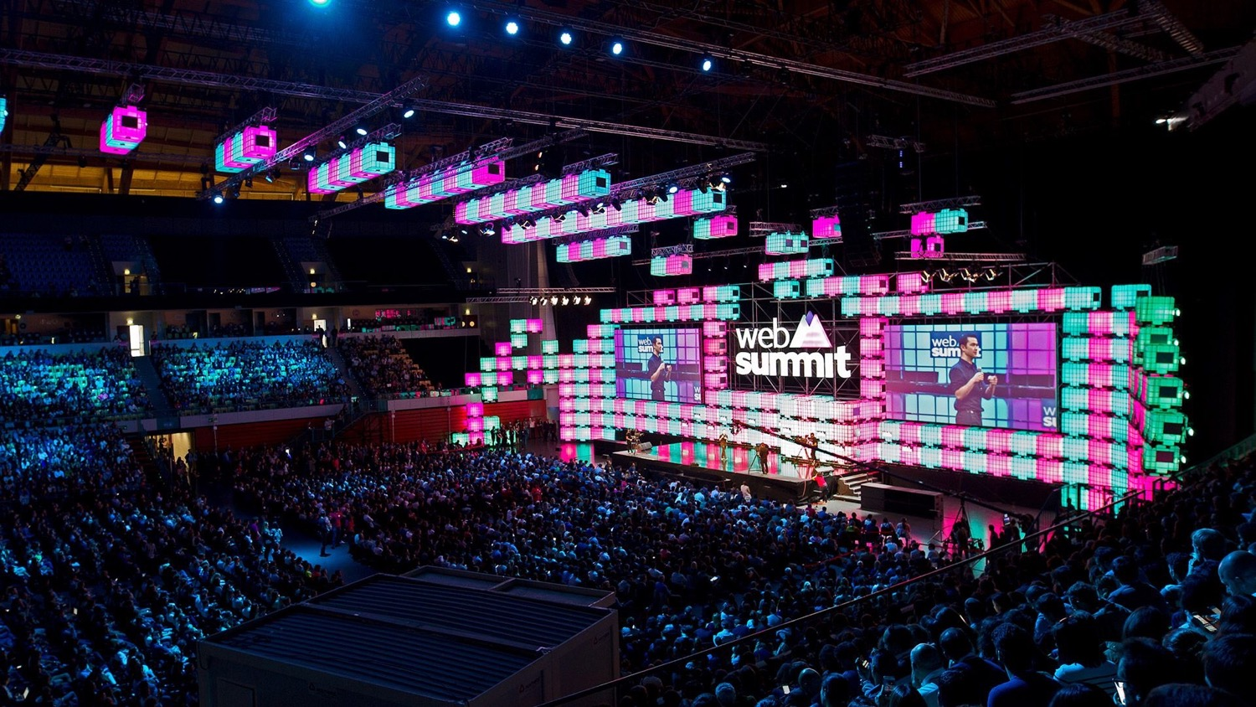
Events 2018-19

Slide 31





Participating events 2018 - 19
6 – 9, Chicago
8 – 11, Rovinj
September
February
May
October
March
12 – 14, Los Angeles
25 – 28, Barcelona

Slide 32














Proposed events 2018 - 19
5 - 8, Lisbon
1- 4, Cebu
Dubai
5 - 6, Kigali
28 – 29, London
16 – 17, London
5 - 7, San Francisco
13 – 14, Madrid
5 - 6, Hong Kong
Bangkok
June
Oct
Feb
May
Sept
Nov | Dec
March
12 – 14, London
21 - 24, Las Angeles
6 – 8, London
27 – 29, Shanghai
23 – 25, London

Slide 33
Route Mobile and Competitors
 | Route Mobile | Infobip | Mgage | CLX | IMI Mobile | Syniverse | MessageBird | Tyntec | Twilio | BICS
Mobile World Congress | Yes | Yes | Yes | Yes | Yes | Yes | Yes | Yes | Yes | Yes
GSMA WAS | Yes | Yes | No | Yes | No | Yes | No | Yes | Yes | Yes
Wholesale World Congress | Yes | Yes | No | No | No | No | No | Yes | No | Yes
ICE Totally Gaming | Yes | No | Yes | Yes | Yes | No | No | No | No | No
Capacity Conferences | Yes | Yes | No | Yes | No | No | No | No | No | Yes
International Telecoms Week (ITW) | Yes | Yes | No | Yes | No | Yes | No | Yes | No | Yes
Mobile World Congress Americas | Yes | Yes | No | Yes | No | Yes | Yes | Yes | No | Yes
Mobile World Congress Shanghai | Yes | Yes | No | Yes | No | Yes | Yes | No | No | Yes
Messaging & SMS World | Yes | Yes | No | Yes | No | Yes | No | No | Yes | Yes
Africacom | Yes | Yes | No | Yes | Yes | Yes | No | No | No | Yes
Web Summit | Yes | Yes | Yes | Yes | No | No | Yes | Yes | Yes | Yes
TechCrunch | Yes | No | No | Yes | No | Yes | Yes | No | No | No
Asian Carrier Conference | No | Yes | No | Yes | No | Yes | No | No | No | No
Money 20/20 | No | Yes | No | No | No | Yes | No | No | No | No
Eneteprise Connect | No | No | Yes | No | No | No | Yes | No | Yes | Yes
Seamless Conferences | No | Yes | No | Yes | No | No | No | No | No | No
Rise - Hong Kong | Yes | No | No | No | No | No | No | Yes | Yes | No

Slide 34
Future participation
Criteria ranked
  Relevance to business
  Industry
  Exhibitors / visitors/ speakers
  Attendee/ visitor profile
  Participating competitors
  Link to upcoming Route Mobile product
  New information potential
  Location/ accessibility
  Lead generation potential
  Cost feasibility and returns

Slide 35




Banking and Fintech
19 – 21 March, Singapore
150 Exhibitors
2000 visitors
160 speakers
CxO/ Upper-Middle Mgmt level attendance
Participating Competitors
  Infobip
  Syniverse
Upcoming product relevance :
Acculync 2.0
Route OTP 2.0
Multi/ Omni channel A2P
4 – 6 June, Amsterdam
150 Exhibitors
5000 visitors
200 speakers
CxO/ Upper-Middle Mgmt level attendance
Participating Competitors
  Infobip
  Syniverse
Upcoming product relevance :
Acculync 2.0
Route OTP 2.0
Multi/ Omni channel A2P
11 – 13 June, Dublin
7000 visitors
300 speakers
CxO/ Upper Mgmt level attendance
Participating Competitors
  Infobip
  Syniverse
  CLX
  BICS
Upcoming product relevance :
Acculync 2.0
Route OTP 2.0
Multi/ Omni channel A2P
21 – 24 October, Las Vegas
400 Exhibitors
11,500 visitors
500 speakers
CxO/ Upper-Middle Mgmt level attendance
Participating Competitors
  Infobip
  Syniverse
Upcoming product relevance :
Acculync 2.0
Route OTP 2.0
Multi/ Omni channel A2P

Slide 36




Retail & e-commerce
15 – 17 Jan, New York
700 exhibitors
40,000 visitors
300 speakers
CxO/ Upper-Middle Mgmt level attendance
Participating Competitors
  mGage
Upcoming product relevance :
Acculync 2.0
Route OTP 2.0
Deep-linking
Multi/ Omni channel A2P
15 – 16 April, Dubai
3 – 4 May, Singapore
350 exhibitors
15000 visitors – Dubai
6000 visitors - Singapore
250+ speakers
CxO/ Upper-Middle Mgmt level attendance
Participating Competitors
  Infobip
  CLX
  mGage
Upcoming product relevance :
Acculync 2.0
Route OTP 2.0
Deep-linking
Multi/ Omni channel A2P
16 – 17 May, Las Vegas
2700 exhibitors
45000 visitors
100 speakers
CxO/ Upper Mgmt level
attendance
Participating Competitors –
N/A
Upcoming product relevance :
Acculync 2.0
Route OTP 2.0
Deep-linking
Multi/ Omni channel A2P
6 – 7 March, Munich
400 exhibitors
16,7470 visitors
250 speakers
CxO/ Upper-Middle Mgmt level attendance
Participating Competitors
  N/A
Upcoming product relevance :
Acculync 2.0
Route OTP 2.0
Deep-linking
Multi/ Omni channel A2P

Slide 37




Travel & Hospitality
25 – 28 Jan, Istanbul
700 exhibitors
50, 000 visitors
25 speakers
CxO/ Upper-Middle Mgmt level attendance
Participating Competitors
  N/A
Upcoming product relevance :
Deep-linking
IP Messaging
Multi/ Omni channel A2P
6 – 8 March, Berlin
1,000 exhibitors
50000 visitors
CxO/ Upper Mgmt level
attendance
Participating Competitors –
Tyntec
IMI Mobile
Upcoming product relevance :
Deep-linking
IP Messaging
Multi/ Omni channel A2P
16 – 18 Sept, Dubai
350 exhibitors
50,000 visitors
CxO/ Upper-Middle Mgmt level attendance
Participating Competitors
  Infobip
Upcoming product relevance :
Deep-linking
IP Messaging
Multi/ Omni channel A2P
18 – 19 October, Las Vegas
60 exhibitors
500 visitors
80 speakers
CxO/ Upper-Middle Mgmt level attendance
Participating Competitors
  Infobip
Upcoming product relevance :
Deep-linking
IP Messaging
Multi/ Omni channel A2P

Slide 38




IoT & Tech
14 – 17 May, California
320 exhibitors
12, 000 visitors
460 speakers
CxO/ Upper-Middle Mgmt level attendance
Participating Competitors
  Infobip
  BICS
  CLX
  IMI Mobile
Upcoming product relevance :
Acculync 2.0
Route OTP 2.0
Deep-linking
IP messaging
Multi/ Omni channel A2P
11 – 13 July, Hong Kong
300 exhibitors
15000 visitors
200 speakers
CxO/ Upper Mgmt level
attendance
Participating Competitors –
Tyntec
Upcoming product relevance :
Acculync 2.0
Route OTP 2.0
Deep-linking
IP messaging
Multi/ Omni channel A2P
12 – 14 June, London
300 exhibitors
15,000 visitors
150 speakers
CxO/ Upper-Middle Mgmt level attendance
Participating Competitors
  Infobip
  BICS
  CLX
  IMI Mobile
Upcoming product relevance :
Acculync 2.0
Route OTP 2.0
Deep-linking
IP messaging
Multi/ Omni channel A2P
5 – 7 Sept, San Francisco
300 speakers
CxO/ Upper-Middle Mgmt level attendance
Participating Competitors
  Syniverse
  CLX
  Messagebird
Upcoming product relevance :
Acculync 2.0
Route OTP 2.0
Deep-linking
IP messaging
Multi/ Omni channel A2P

Slide 39


14 – 18 October, Dubai
5000 exhibitors
80, 000 visitors
200 speakers
CxO/ Upper-Middle Mgmt level attendance
Participating Competitors
  Infobip
  ValueFirst
  Tyntec
  IMI Mobile
Upcoming product relevance :
Acculync 2.0
Route OTP 2.0
Deep-linking
IP messaging
Multi/ Omni channel A2P
5 – 8 November, Lisbon
1500 exhibitors
65,000 visitors
650 speakers
CxO/ Upper Mgmt level
attendance
Participating Competitors –
Infobip
mGage
CLX
MessageBird
Tyntec
Twilio
BICS
Upcoming product relevance :
Acculync 2.0
Route OTP 2.0
Deep-linking
IP messaging
Multi/ Omni channel A2P

Slide 40



iGaming
17– 20 April, Las Vegas
400 exhibitors
20, 000 visitors
460 speakers
CxO/ Upper-Middle Mgmt level attendance
Participating Competitors
  Infobip
Upcoming product relevance :
Deep-linking
Multi/ Omni channel A2P
3 – 5 July, Barcelona
1000 visitors
200 speakers
CxO/ Upper Mgmt level
attendance
Participating Competitors –
IMI Mobile
Upcoming product relevance :
Deep-linking
Multi/ Omni channel A2P
8 – 11 October, Las Vegas
450 exhibitors
26,000 visitors
CxO/ Upper-Middle Mgmt level attendance
Participating Competitors
  IMI Mobile
Upcoming product relevance :
Deep-linking
Multi/ Omni channel A2P

Slide 41




India Events
1– 3 Feb, Mumbai
200 exhibitors
10, 700 visitors
460 speakers
CxO/ Upper-Middle Mgmt level attendance
Participating Competitors
  N/A
Industry:
Banking
FinTech
Payments
7 – 9 March, New Delhi
600 exhibitors
30,000 visitors
25 speakers
CxO/ Upper Mgmt level
attendance
Participating Competitors –
mGage
IMI Mobile
Industry:
Technology
Start-ups
IoT
8 – 9 March, New Delhi
115 exhibitors
65,000 visitors
100 speakers
CxO/ Upper-Middle Mgmt level attendance
Participating Competitors
  Infobip
  IMI Mobile
Industry:
Technology
Start-ups
IoT
1 – 2 Sept, Bangalore
50 speakers
7,000 visitor
CxO/ Upper-Middle Mgmt level attendance
Participating Competitors
  N/A
Industry:
Technology
Start-ups
IoT

Slide 42


25 – 27 October, New Delhi
500 exhibitors
20,000 visitors
CxO/ Upper-Middle Mgmt level attendance
Participating Competitors
  Infobip
  ValueFirst
  IMI Mobile
Industry:
Technology
Apps
Teleco
2019, India
45,000 visitors
300 speakers
CxO/ Upper Mgmt level
attendance
Participating Competitors –
Infobip
IMI Mobile
Industry:
e-commerce
Retail
Service
Tech
Start-ups

Slide 43
Key performance indicators (KPI)
Factors involved
  No. of attending staff
  No. of event days
  No. of exhibitors/ visitors
  CTC incurred for event
  Off event business potential

Slide 44
Example scenario
Exhibition location – USA
Total exhibitors – 500
Total visitors – 10,000
Total staff attending – 3
500
Exhibitors
300
Approached
150
Leads generated
45
Prospective leads
7
Converted leads
60% hit
50% hit
30% hit
15% hit
Other avenues of business meetings
  Meet with trade visitors
  Arranging off-event meetings
  Meet with existing clients and pitch more business opportunities

Slide 45
Tracking and lead follow-up
Lead tracking
  Number of company met/ leads generated
  Segregation of good leads/ potential business leads generated
  Cost-per-lead
  Event costs vs event profits (est.)
  Revenue generated from leads
  Quarterly lead follow-ups

Slide 46

Merchandise

Slide 47


Brand
Promotion
Brand Awareness
Merchandise
Goodwill
Attract
Audience

Slide 48
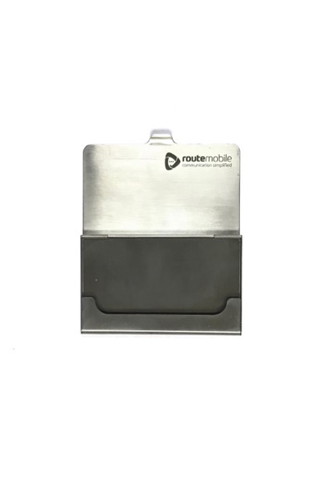
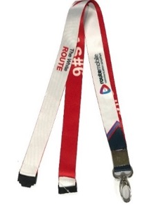
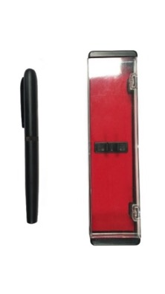
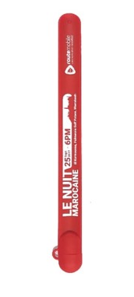
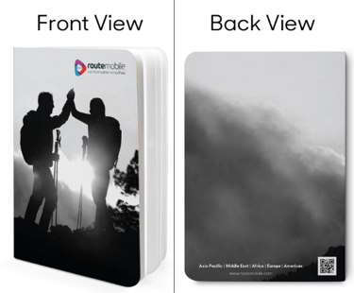

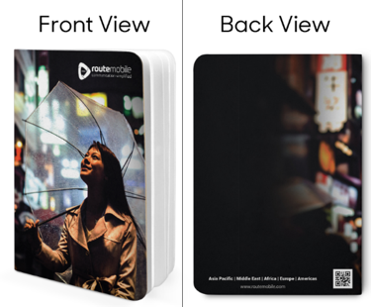
Merchandise procured in the past

Slide 49
Criteria Ranked
Utility
Usage
Value to user
Cost factor
Brand awareness

Slide 50
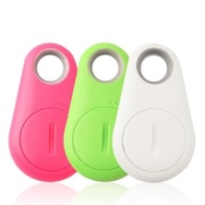
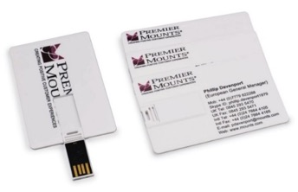
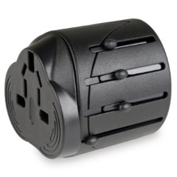
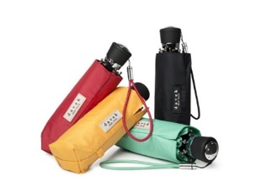

Proposed for MWC Americas
Bluetooth / RFID item finders
Utility – Medium High
Usage – Medium high
Value to user – Medium high
Cost – Rs. 400 – Rs. 1000
USB+Business Cards
Utility – Medium High
Usage – High
Value to user – High
Cost – Rs. 400 – Rs. 600
Universal travel adaptor
Utility – Very high (while travelling)
Usage – Very high
Value to user – Very high
Cost – Rs. 300 – Rs. 1000
Mini umbrellas
Utility – High
Usage – Medium
Value to user – Medium
Cost – Rs. 500 – Rs. 1000
Magnetic pens (ball point)
Utility – Medium
Usage – Medium
Value to user – Medium
Cost – Rs. 100- Rs. 150

Slide 51
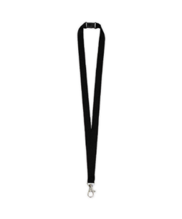
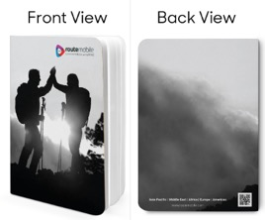

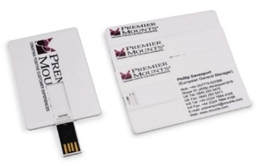
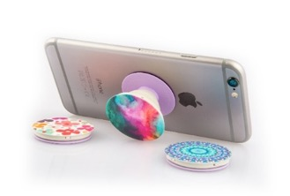
Proposed for WAS#8
Note Books (A5 size)
Utility – High
Usage –High
Value to user – Medium
Cost – Rs. 100– Rs. 150
Magnetic pens (ball point)
Utility – Medium
Usage – Medium
Value to user – Medium
Cost – Rs. 100- Rs. 150
Lanyards
Utility – Low
Usage – Low
Value to user – Low
Cost – Rs. 40- Rs. 60
USB+Business Cards
Utility – Medium High
Usage – High
Value to user – High
Cost – Rs. 400 – Rs. 600
Pop-socket
Utility – Medium
Usage – Medium
Value to user – Medium
Cost – Rs. 200– Rs. 500

Slide 52
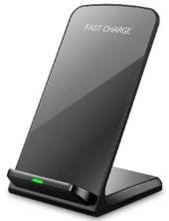
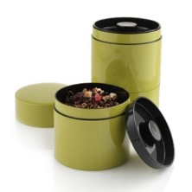

Proposed for MWC Barcelona (2019)
Universal travel adaptor
Utility – Very high (while travelling)
Usage – Very high
Value to user – Very high
Cost – Rs. 300 – Rs. 1000
USB+Business Cards
Utility – Medium High
Usage – High
Value to user – High
Cost – Rs. 400 – Rs. 600
iPhone wireless charger
Utility – High
Usage – High
Value to user – High
Cost – Rs. 700 – Rs. 3000
Flavoured Tea tins
Utility – Medium
Usage – Medium
Value to user – High
Cost – Rs. 200– Rs. 300
Note Books (A5 size)
Utility – High
Usage –High
Value to user – Medium
Cost – Rs. 100– Rs. 150

Slide 53
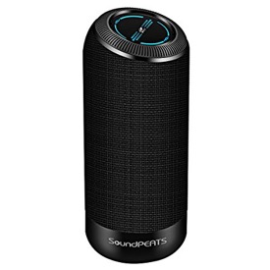
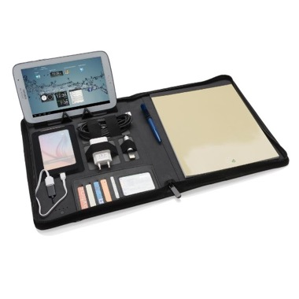
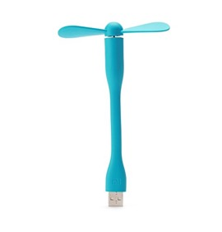
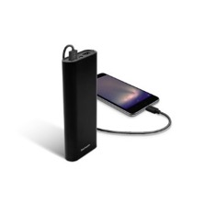

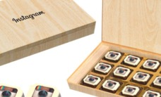
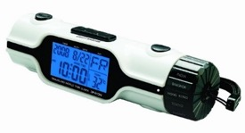
Future Merchandise Ideas
USB Fans
Bluetooth Speakers
Tech Portfolio
Power Bank
Route Mobile Sweet Box
T-shirts
Multi-utility alarm clock

Slide 54
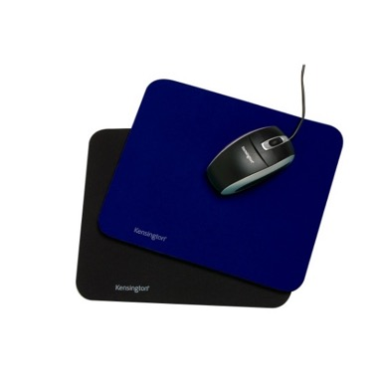

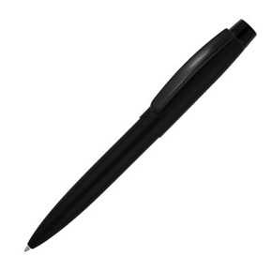

Internal Merchandise
Diaries
Pens
Mousepads
Hoodies

Slide 55




Design
Design in Marketing

Slide 56
Aesthetics
Logo / Font / Colour Palette / Stock Imagery / Iconography

Slide 57
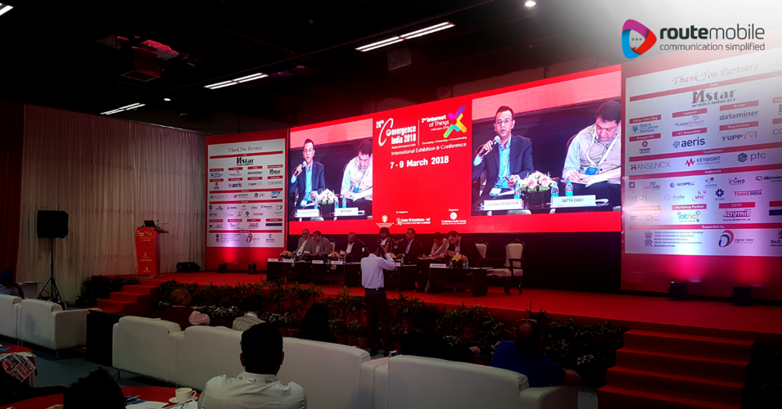
Logo Placement (As is)
Needs a white background always
Created a weird glow in every design which was not uniform

Slide 58
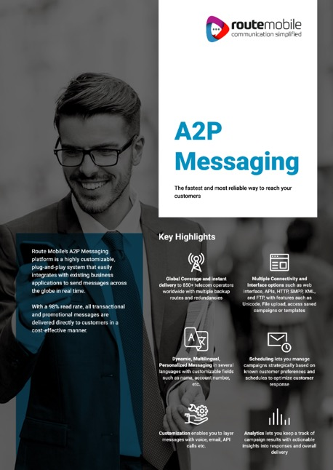
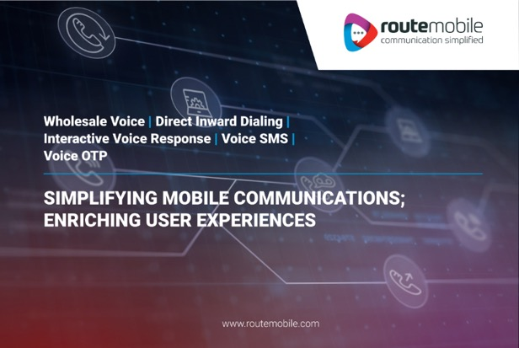
Logo Placement (To be)
We add a band coming from side
Due to this, we don’t need to alter the photo to have a white glow
Band highlights the area of the logo

Slide 59
Font
Thin style was used through the designs
Moving to a thicker style gives a bolder look to the brand and the message we try to pass
Use of font weightage style to show hierarchy in text
Roboto is the primary font used throughout all the design
Secondary font ‘Calibri’ to be used when Roboto not available
Roboto (Primary)
Calibri (Alternate)
A Glimpse on How Telecommunications, More Specifically Wholesale Voice is Reinventing
A Glimpse on How Telecommunications, More Specifically Wholesale Voice is Reinventing
A Glimpse on How Telecommunications, More Specifically Wholesale Voice is Reinventing
A Glimpse on How Telecommunications, More Specifically Wholesale Voice is Reinventing

Slide 60
Colour Palette
SECONDARY
SECONDARY
PRIMARY
For Branding Elements
For Iconography Weightage
For Typography Weightage

Slide 61


Stock Imagery
Greyscale was the only colour tone used on photos
Moving from grayscale to colour to bring out the depth and vibrancy in the photo

Slide 62

Iconography
Static icons with blue as primary colour
To differentiate between types, we use different colour from the palette
Remains as one brand element for recognition
Heavy usage in motion graphics in infographics

Slide 63
Digital & Collaterals
Social Media / Blogs / Case Study / Website / Booth

Slide 64
Social Media
Templating everything reduces time consumption during creation
Able to dedicate more time towards newer designs
Templates divided into following categories
  Events
  Hiring
  Products
  Friday Fact
  Life at RML
  Case Studies
  Industry Links

Slide 65
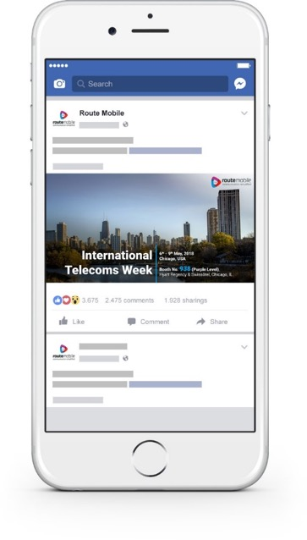
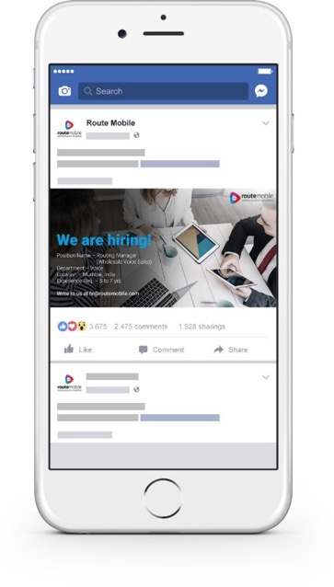
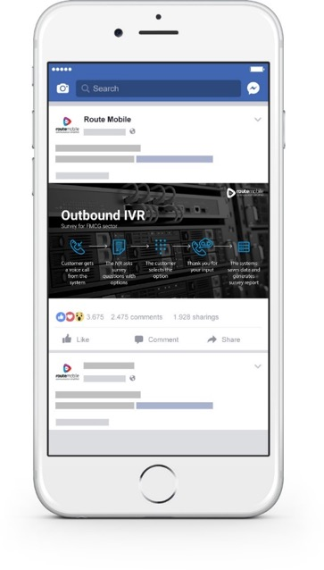
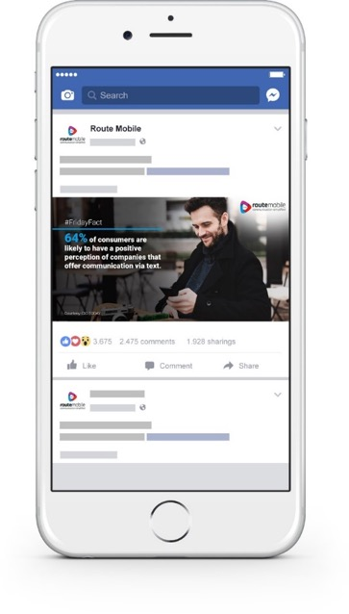
Social Media Applications
Events
Hiring
Products
(motion graphics)
Friday Fact

Slide 66
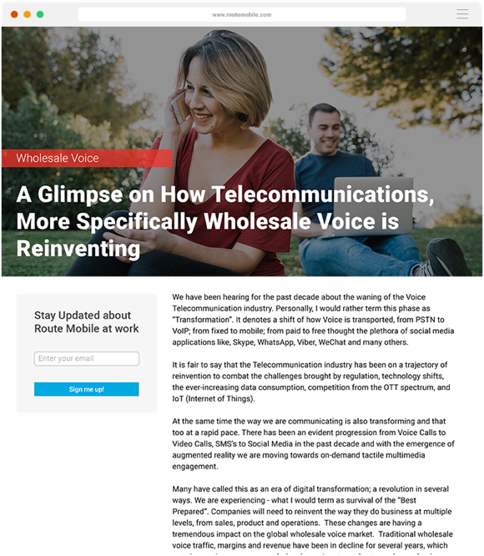
Blogs
Blogs to have motion graphic diagrams, infographics and static images to represent section headers
Categorised on the basis of authors and products using keywords

Slide 67
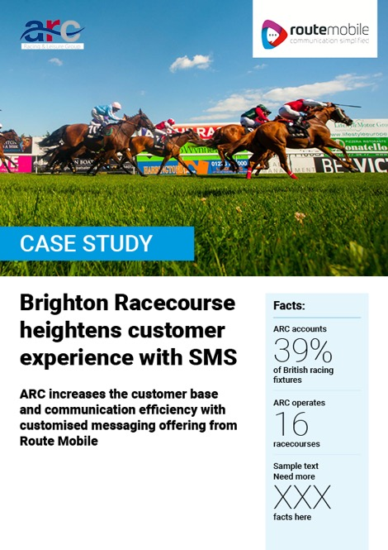
Case Study
Case studies to be as a webpage as well as an attached PDF for offline viewing

Slide 68
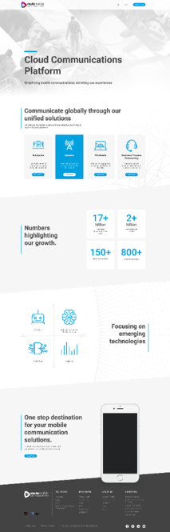



Website
In-house v1
Agency v1
Agency v2
In-house v2

Slide 69
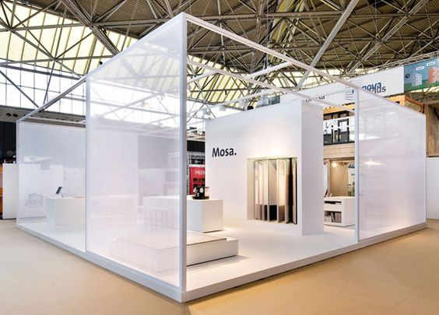
Booth
Large panels/walls for products
Panels that are
see-through to have technology
Open lounges and spaces
This is for representation purpose and shall not be executed in events

Slide 70

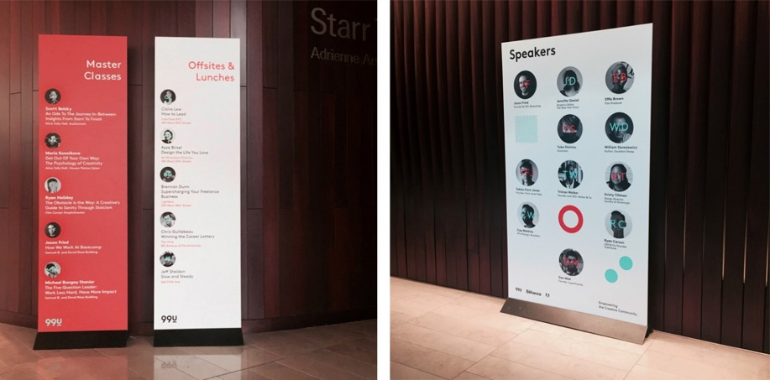
Booth elements
Loose panels to showcase products which are interactive and can be turned into screens
This is for representation purpose and shall not be executed in events

Slide 71
MWC, 27 – 29 Shanghai
Product launch - Route Mailer
1 – 2 Media Interviews
1 Relationship Building Meeting
Content: 3-5 Blogs
1 Newsletter
Event – MWCS Live updates
MWCS Push PR articles, BLOGS, case studies on social media forum
Product launch – IP Messaging
1 – 2 Media Interviews
1 Relationship Building Meeting
Content: 3-5 Blogs
1 Newsletter
Event Build-up - MWC- A, ACC & WWC. Push PR articles, BLOGS, case studies on social media forum
WAS#8, 8 – 11 Rovinj
Product launch - Route International calling
1 – 2 Media Interviews
1 Relationship Building Meeting
Content: 3-5 Blogs
1 Newsletter
Event – WAS#8 promotions. Push PR articles, BLOGS, case studies on social media forum
1 – 2 Media Interviews
1 Relationship Building Meeting
Content: 3-4 Blogs
1 Newsletter
Push PR articles, BLOGS, case studies on social media forum
ICE, 6 – 8 London
MWC, 25 – 28 Barcelona
1 – 2 Media Interviews
1 Relationship Building Meeting
Content: 3-4 Blogs
1 Newsletter
Event – MWC Live Updates
Push PR articles, BLOGS, case studies on social media forum
Corp Announcement - IDEA partnership
1 – 2 Media Interviews
Design – Website designing
April
May
June
July
Aug
Sept
Oct
Nov
Dec
Jan
Feb
Mar
ITW 2018, 6 – 9 Chicago
The Business Show, 16 – 17 London
Corp Announcement - IPO announcement
1 – 2 Media Interviews
1 Relationship Building Meeting
Authored Article
Content: 3-4 Blogs
1 Newsletter
Event posting - ITW & TBS
Push PR articles, BLOGS on social media forum
Product launch – Acculync 2.0
1 – 2 Media Interviews
1 Relationship Building Meeting
Authored Articles
Content:3- 4 Blogs
1 Newsletter
Push PR articles, BLOGS, case studies on social media forum
MWC Americas, 12 – 14 LA
Product launch - Route Easy Conferencing & Route Masking
1 – 2 Media Interviews
1 Relationship Building Meeting
Content: 3-5 Blogs
1 Newsletter
Event – ITW & TBS Live updates. MWC Shanghai Build up. Push PR articles, BLOGS, case studies on social media forum
1 – 2 Media Interviews
1 Relationship Building Meeting
Content: 3-4 Blogs
1 Newsletter
Event buildup – MWC 2019 ICE Build up. Push PR articles, BLOGS, case studies on social media forum
WebSummit
1 – 2 Media Interviews
1 Relationship Building Meeting
Authored Article
Content: 3-5 Blogs
1 Newsletter
Event – WebSummit promotions. Push PR articles, BLOGS, case studies on social media forum
1 – 2 Media Interviews
1 Relationship Building Meeting
Content: 3-5 Blogs
1 Newsletter
Push PR articles, BLOGS, case studies on social media forum
PR & Corp Com - Press Release, One-on-one interactions, relationship building meetings, media familiarisation Trip , authored articles (bi-monthly), themed interviews (1-2 every mnt)
Content – Blogs, newsletters, case studies, infographics/videos
Social media – IPO articles, RML product write-up, business news, innovation and technology news, blogs

Slide 72
Thank You!

