Slide 1
V. K. ICL Marketing Proposal

Slide 2
Table Of Contents
Introduction - To brand, offerings, Vision, Mission and Objectives
Selection of Medium - Channels of Marketing - Platforms, Game Plan, Objectives etc
Understanding of Brand - Positioning - Umbrella Communication/Mother Campaign etc - Competition Analysis
Approach and Strategy

Slide 3
Introduction

Slide 4
Introduction
V.K. ICL
We are a power house of versatile steel products with 35 years of industry experience and diverse inventory to serve major industry sectors with exceptional customer service
OUR INDUSTRIES
- Automobiles
-Renewable power
Infrastructure
Yellow goods and machinery
White Goods
Nuclear and hydro power plant
Oil and Gas pipeline
Shipbuilding
Engineering
OUR VISION & PURPOSE/ MISSION
To meet the growing infrastructural needs of India - To be a leading steel distributer at competitive prices to and help strengthen Indian economy
OBJECTIVES
To simplify and ease the access for the people who are looking for raw material
To be a go-to market player when it comes to everything steel - To be a trusted steel products supplier and serve the existing and potential customers efficiently

Slide 5
Selection of Medium

Slide 6
Channels Of Marketing
Social Media
Identify the platforms, know the audience, device an online strategy, prepare content and engage with the audience and remarketing
Events
Identify the events, build a hype of participation on digital, get a participation booth, showcase your product, attractive giveaways, Word Of Mouth (WOM) reach
OOH Ads
Out of home hoardings, bus shelter adverts, Flyers, marketing collaterals handouts, local congregation events shelters etc.
CSR/Community events
Giveaways in terms of CSR such as branded Tshirts for the needy and getting a testimonials from the end audience, funding small community league sports and other events

Slide 7
Platforms of Engagement
Primary focus platforms
Awareness
Engagement
Secondary focus platforms
Traffic
Lead Generation
The chronological order of the platforms represent the relevancy of the platform for the corresponding ‘objective’

Slide 8
Social Media Game Plan
Expand
Utilizing multiple social media platforms more efficiently
Using specific features of different social media platforms to reach out to more & more audience
Optimum utilization of integrated social media platforms
4
1
6
Content
Interesting content baskets
Sharable content
Providing Value
Giving out information
Being useful
Trends
Keeping finger on the pulse of the trends
Keeping our eyes open
Making most of any opportunity that comes up
2
7
Branding
Templatizing brand related posts
Adding brand elements to crafted posts
Consistency with logo, colors, fonts & graphics
Engage
Generate conversations
Stay involved in the conversations
Social Media Approach
8
Monitor
keeping overall strategy in line with the overall objectives
Monitoring all the activities on all the social platforms.
Keeping track of posts high level + detailed, Long term + daily
3
Tactic
Efficient mix of different content pieces
Posting regularly
Posting strategically
5
Interactive
Being fun
Being useful
Being interesting

Slide 9
Primary Objective
Create awareness about our the brand amongst our target audience
Create, build and curate an online community for the brand through online channels
Trigger conversations & engagement on these channels, increase website traffic and build brand identity

Slide 10
Branding Understanding & Positioning

Slide 11
What We Know
VKI aims to be a recognized player in the steel market and wants to deliver value to its current customer base so that through the word of mouth we can expand our customer loyalty
We strive to serve our customers with state of the art steel raw material and at attractive prices as compared to our competitors
Our main goal is to help serve across industries as steel is an important element to all be it a business to customer or business to business sector market
We believe in giving a helping hand to transforming and helping Indian economy grow into a developed country by providing the best raw material needed for infrastructure betterment

Slide 12
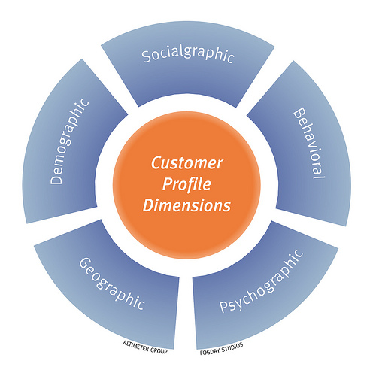
Defining The Target Audience
Likely target group from the age of 25 – 45+ - 25 to 35 years audience are consumers plus they create awareness - 35 – 45+ are consumers, help brand awareness, business growth, employer branding etc
Status - City and town dwellers with medium & high disposable income
Demographic & Geographic – Young, working as well as non working professionals in the tier I and II cities
Behavioural traits – Mobile, Tech and Internet savvy, health conscious, lifestyle oriented, online shoppers, studying and budding engineers, architects etc.
Seniority – Sales and admin professionals of other companies, decision makers of small businesses, contractors, small enterprise owners etc.

Slide 13
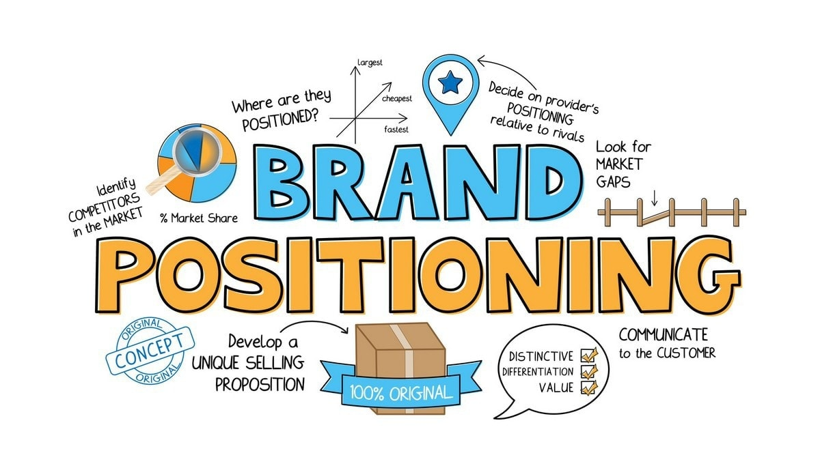
Positioning
The target audience is of two distinct types –
Our existing and potential customers
Our digital fan base which will give us the word of mouth exposure and brand awareness in the market and will in turn convey our methodologies to the world
The positioning of VKI in such a marketplace is to be seen as an aggregator steel provider who is behind all fascinating infrastructure and constructions as well as small time innovations that the current world is experiencing
The unique selling point would be the small things which go unnoticed by the high level view when it comes to development of a country in which steel plays an important part

Slide 14
Umbrella Communication - #SteelTheShow
Main Communication Peg – We have an overall term or SLOGAN on which all our conversations and communication will be based which is exactly related to our product which we deal in #SteelTheShow
As we are referring to the daily scenarios via a set of illustrations and images from our routine backgrounds to ascertain the importance of steel we can use the hashtags given alongside for our communication as it is a vast concept we can build campaigns around it and create ample amount of content for our digital channels using various hashtags
The use of Hinglish and English copy combined with hashtags like #EkAtootRishta or a #ABondForLife will get the fan base to engage more with our brand creating user generated content related to Sports, Bollywood, Television, Politics and Topical content etc.
# EkAtootRishta
# YourLifeCompanion
# WeCompleteYou

Slide 15
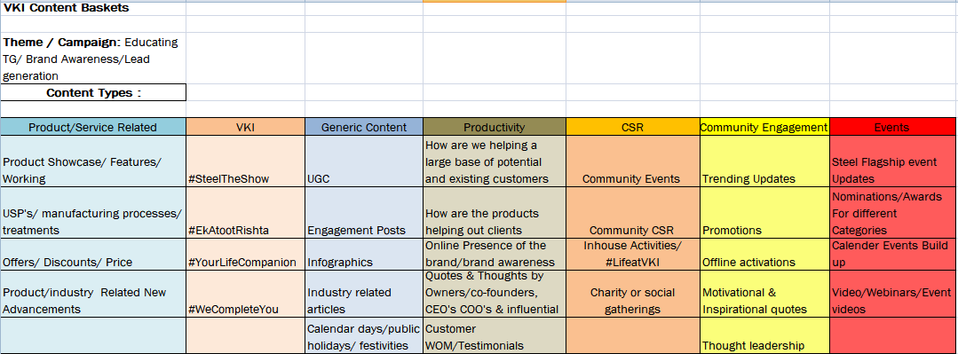
Content Baskets and Segregation Plan
These are the content modules around which content will be generated and shared on our digital platforms to generate conversations and engagement for our brand and to build a community.

Slide 16
Strategy & Approach

Slide 17
Competition Analysis
Platform
Company
V.K. Industrial Corp ltd
1048
NA
1102
NA
NA
SB ISPAT
4
4
NA
NA
NA
DM Sons
NA
NA
NA
NA
NA
Tata steel Ltd
245626
70829
494210
19633
20600
Arcelor Mittal nipon
56300
9912
19193
NA
NA
TATA Steel has a huge presence and the numbers which are showing are because of heavy paid audience acquisition

Slide 18
Strategy and FAQs
Slogan suggestion – I suggest we reiterate it to ‘ A strong noticeable bond’ or ‘We are omnipresent’ because steel is where we are and steel is almost present in everything so that and plus choose green and coloring the whole creative yellow contradicts
Strategies to engage TG - The core strategy is to make the content related and engagable where people relate to the content into their day to day life and hence can come up with memes or their own generated content so that they have talking points around the communication pegs which we initiate
Paid or Organic – There is no harm in doing paid but we first should get a gist of the content which we have created and its impact on the audience and only then decide whether to pump it with money. As far as budget goes 500-600 Rs a post a day is good enough on any platform
Hashtags - #SteelTheShow #YourLifeCompanion #EkAtootRishta #WeCompleteYou are some the hashtags which I suggest should go better with this campaign and I guess #SteelTheShow is a hashtag which we should make it branded one for every further communication
Matrix and Analysis - To monitor at the end of the month we will generate a monthly report of how the posts worked and which type of content/post has got the most traction on FB/Linkedin and we continue to enhance that type of content to keep the audience engaged Ideal caption – VKI – Adding a pinch of patience, a dash of kindness and a spoonful of laughter and a heap of love to the most unforgettable dinner dates with your beloved ones. #SteelTheShow #EkAtootRishta #ABondOfLove

Slide 19
Social Media Approach
Closely monitor competitor social media and create a content calendar based on the content basket and reiterate the content according to what is getting more traction for our competitors
Based on the keyword research we try and incorporate keywords into our communications
Monitor the big players in the same business and follow the bandwagon in terms of content marketing strategy
Get brand recognition with USP or Unique Keywords which are exclusive to our brand
Finally keep entertaining the target audience

Slide 20
THANK YOU

