Slide 1
Presents

Slide 2
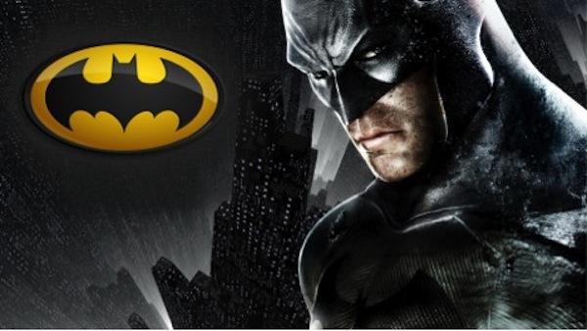
Batman Begins
A new range of your favorite superhero Batman T-shirts

Slide 3
Campaign Thought

Slide 4
BE THE KNIGHT!

Slide 5
Platforms

Slide 6
Phases
Teaser Phase
Launch Phase
Post-Launch Phase
(Build-up a community)
(Create Awareness and engage)
(Gratify and Sustain)

Slide 7
Teaser Phase
This is the build up phase where we create intrigue about Vox Pop’s new product ie. Batman t-shirts which are going to be available for purchase.
Idea – What Does Your T-Shirt Say?
This idea will basically revolve around how or what your t-shirts feel.

Slide 8
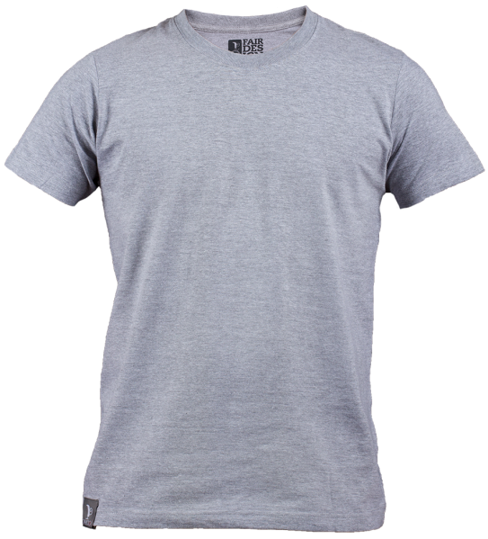
What Does Your T-Shirt Say?
We can do such series of posts where in we can give out the plight of a t-shirt etc.
Also letting them know through these posts that there is a range of Batman t-shirts that are coming out to build up a community.
Why you no paint me?
Batman Begins Coming Soon

Slide 9
What Does Your T-Shirt Say?
We can have conversations on twitter for this build up phase idea and build a community of t-shirt and batman lovers.
We can tap them by using hashtags such as #MyBatmanFantasy or #MyTshirtStory.
These generic hashtags will have to be used by a set of influencers telling their story.
Tweet – What your ultimate #MyBatmanFantasy? Tweet and let us know.
Replies - I want to sketch the next villain for Batman. #MyBatmanFantasy
This will create intrigue about the word batman and then we let out our new collection of tshirts.

Slide 10
What Does Your T-Shirt Say?
As the name of the brand goes we can actually Vox Pop videos which are crowd sourced.
Asking people about their Tshirt story or funny video content around what does your tshirt say?
We can then share it from our official Facebook and Twitter pages.

Slide 11
Launch Phase
This is the phase wherein we create awareness about out product and engage with our fans.
Idea – Vox Pop DIY (Do It Yourself) contest
This idea is just for our fans and hardcore batman fans and also artists who have a chance to show their talent.

Slide 12
VOXPOP DIY Contest
We do a series of posts where we give people a chance to design their own t-shirt.
We tap all the sketch artists, designers and visualiser’s who are also huge followers of The Dark Knight.
This will be a contest from our official handle to design a Batman and the best will be printed by Vox Pop clothing with sign of the artist.
How many of you have it in you?
#DIYContest
Rules for the contest –
Send us your sketch of Batman.
Tell us a reason why you like Batman
The best sketch will be printed and included in our next collection of T-shirts called Batman Begins

Slide 13
VOXPOP DIY Contest
This phase is for engaging the existing and additional fanbase who are Batman crazy.
We can play a similar contest on twitter where we ask people for Batman quotes using hashtags such as #DIYBatmanContest.
Tweet - Tweet with #DIYBatmanContest and send us a quote for Batman in your words and we will use it for our t-shirts.
We then select the best quotes from our fans and gratify them getting it printed on a Batman Begins t-shirt and giving it away to that fan.

Slide 14
VOXPOP DIY Contest
This can be an activity which will be recorded and posted on our official Youtube channel.
We can have a one day workshop for all the artist who are Batman lovers to gather at one placed and their art be recorded till the end.
These video will then be edited and converted into WOW Reaction videos. For eg. The fast forwarded video of the sand artist or the artist which draws on the roads attracting attention.
These video will tend to have higher reach on social media.

Slide 15
Post-Launch Phase
This phase will revolve around the gratification bit and also the production promotion. We gratify the fans who played our DIY contest and gratify them by promoting our t-shirts with their sketches.
Idea – Thank You Dark Knights
This idea is for gratifying all the participants and also sustaining the buzz of our product launch. We put out UGC content from our page promoting our product along with it.

Slide 16
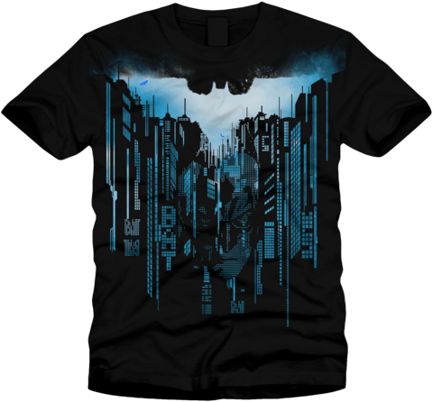
Thank You Dark Knights
We do a series of posts where we put out UGC content which we received on our page and gratify the participants.
This creates interest amongst fans and keeps them hooked on to our page for updates. We sustain the buzz by promoting our T-shirts on our page with upcoming designs etc.
Congratulations! Amar Shah for this beautiful Batman Grafitti

Slide 17
Thank You Dark Knights
On twitter we will be gratifying the winners who took part in our contest and sustain the buzz.
Hashtags which can be used for conversations around these can be #ThankYouBatman, #IfThereWasNoBatman #ForBatmanICan
Tweet – Here’s what one of our fans designed for us. #ThankYouBatman @NiravSingh.
(Tweet Pic) or (website bitly link)
We can also carry the #TheBatmanQuiz in this phase to sustain the buzz.

Slide 18
Thank You Dark Knights
The is an innovative idea just as it was done in the US for a small kid who was suffering from Cancer.
So VOX POP will have a couple of kids from the Orphanage such kind of institution and make them Batman for a day.
They will be shot for the whole day and this can go as a case study video from our page for our campaign with a hashtag #BatmanBattlesCancer

Slide 19
Thank You

