Slide 5
Synopsis
Objective
Campaign
Strategy
Ideas & Content

Slide 6
Synopsis
The story is about a director who has slept with 199 women and wants his 200th partner to be this actress who's a tease.
In the course to pursue her, he offers to play a game with her. The game is that he will tell her some erotic stories and she'll have to strip herself after each story.
The movie revolves around 4 different erotic stories. The girl gets naked after the last story and agrees to sleep with the director.
The movie has several humor punches and double meaning jokes which will leave the audiences stunned.

Slide 7
Objective
Orgy
Scream
Satisfaction
Community Building
Create awareness about the movie
It basically means
Box-Office success

Slide 8
PILLAR OF THE MOVIE

Slide 9
This Summer…

Slide 10
you will experience,

Slide 11
sex like never before

Slide 12
in India’s sexiest film ever!

Slide 13
Campaign

Slide 14
Strategy
THE SETUP
THE TWIST
THE CLIMAX
(Teaser Phase)
(Trailer Phase)
(Pre-Release Phase)

Slide 15
PLATFORMS

Slide 16
Ideas & Content
1. Character Profiling
Meet - ……
Hobbies- Sex
Favourite position- Doggy Style
We introduce the characters of the movie through posts on Facebook
We highlight the attributes of the cast on the placards they will be holding (like during an audition)
The post on the RHS is just a sample of those who have given the audition.
I Love Choco

Slide 17
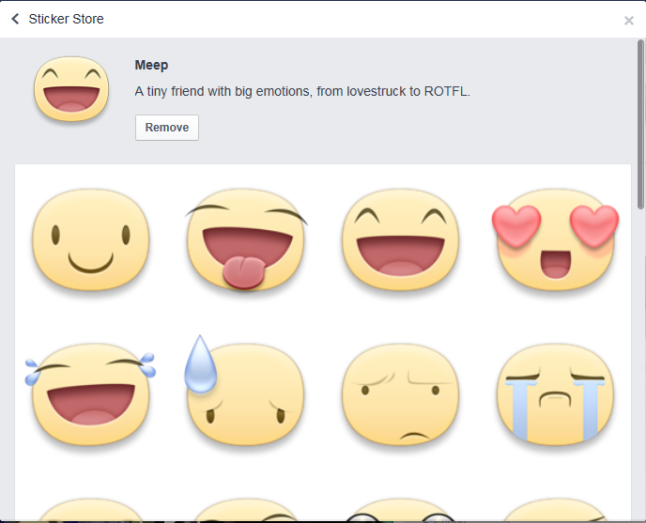
2. XXX emoticons
X.X.X.
We can have a series of emoticons related to the our movie XXX and can launch them before the trailer to create a buzz around the movie

Slide 18
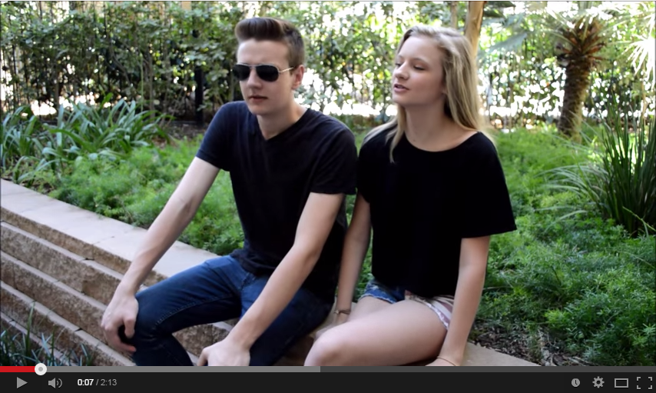
3. X for Sex: YouTube Innovation
A special campaign with Youtube where we reveal the concept of the movie to the people
A simple video featuring the star cast of the movie doing a normal scene and then the video flashes “Press X to get aroused”
As the video progresses in the normal scenario, when the key X is pressed it turns it into an erotic scene where the 200th girl is getting stripped and they move closer to having sex.
The video ends with them going inside a room and the details of release flash on the door of the like a do not disturb sign

Slide 19
4. Trailer/Teaser Launch Idea
Building buzz about the trailer launch by asking fans to use the following hashtags, tweet funny/quirky things etc.
The hashtags to be used will be #XXXBase1, #XXXBase2, #XXXBase3 & #XXXClimax
OR #FlirtForXXX, #ForeplayForXXX, #JerkForXXX & #CumForXXX
The journey to XXX is unique, and to get there fans have to be patient on Facebook & Twitter
Everyday we show them how close they are to the teaser/trailer by showing what they have to do next
The creatives on the page will change according to the levels and every level will keep the fans engaged anticipating as to what is going to happen next
We will release the trailer at the last level. This will happen both on Facebook in the form of posts and on Twitter in the form of contests.

Slide 20
5. Organ-versation
We can have the various organs of the body talking to each other
We will create posts and quiz people on the same or will give them a conversation just for laughs
Eg: Right leg – I feel pity about the leg in between us.
Left Leg – Why?
Right Leg – He’s so short. :P
Right Leg
Left Leg

Slide 21
6. BuzzFeed/ScoopWhoop Tie-Up
We can tie-up with Buzzfeed or ScoopWhoop and do a series of articles and listicles around the concept of the movie
Eg: - 10 things which arouse women the most
- How XXX are you?
- 10 things which are a turn-off for women

Slide 22
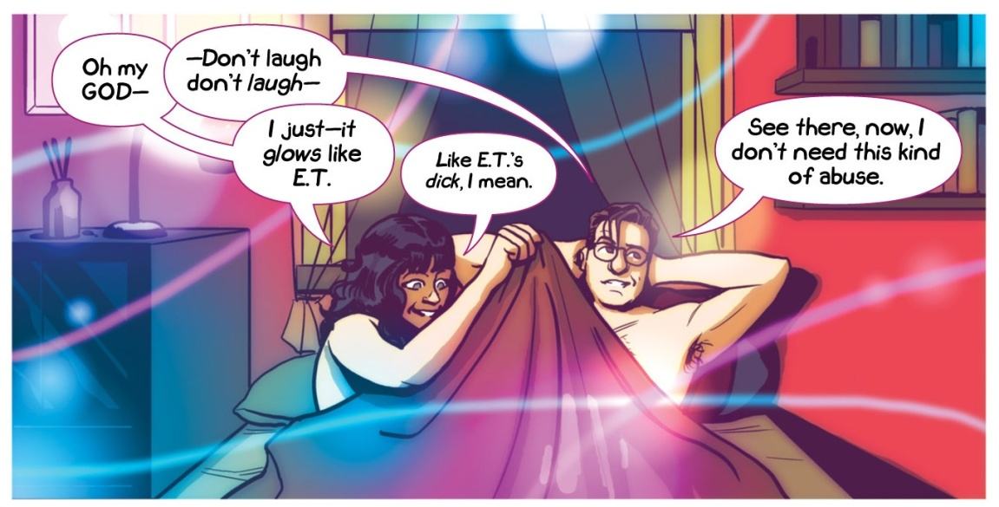
7. Sexy Tiny Tales (Comic Strips)
We can do a series of sexy tiny tales based on witty humor just as the terribly tiny tales
These will based on the plot of the movie and some funny scenes

Slide 23
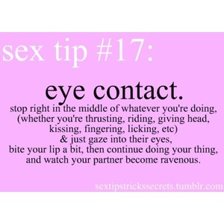
8. Sex Tips
We can do a series of posts or videos where in we can have a sexy girl/guy giving sex/dating tips
We will share on our page for our sex crazy fans so that they can use those tips and send us feedback
The hashtag to be used for this property can be #XXXTips

Slide 24
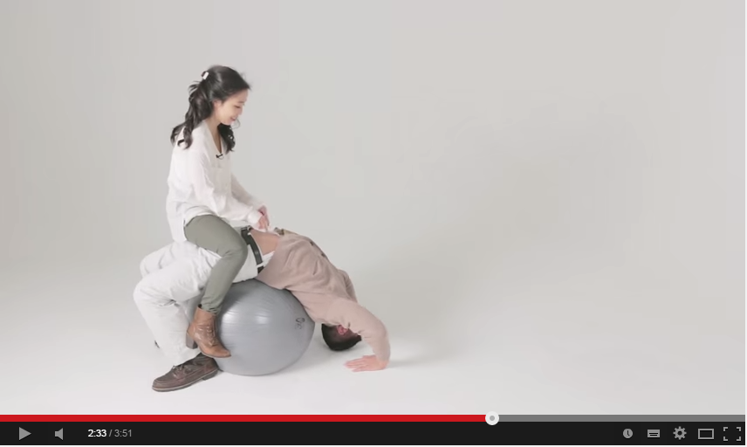
9. Find The Faking Sex Pose
We will shoot a series of videos with couples showing various sex positions
Fans will have to find out whether it is a legit pose or no
We will share these videos on our official Facebook and Twitter

Slide 25
10. What Happened Next?
The girl is waiting in the hotel room,
the boy is at the chemist and …
This will be a content peg for Facebook posts where we will quiz our fans about a certain situation and they will have to tell us the climax
The content of the posts will be around the pillar of the movie
These are interactive posts to gain fan engagement
#WhatHappenedNext

Slide 26
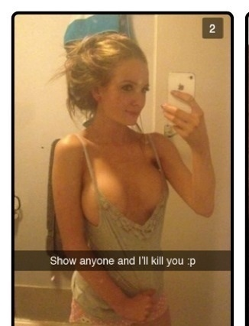
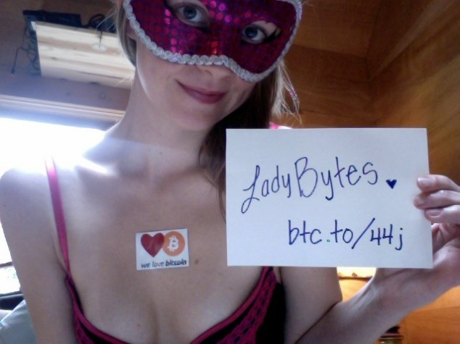
11. Snapchatting XXX-ches
6
The official Snapchat account of the movie will share pictures of girls/boys stripping periodically
This stripping activity will be in a sequence and will create curiosity amongst our fans
The girl/boy (character in the movie) will be stripping in a sequence and then will hold a placard at the end of the activity flashing the release date of the movie or a message to follow our Facebook/Twitter handle to know more.
Hey Guys…Do you want more
8
Get Ready For The Last Level

Slide 27
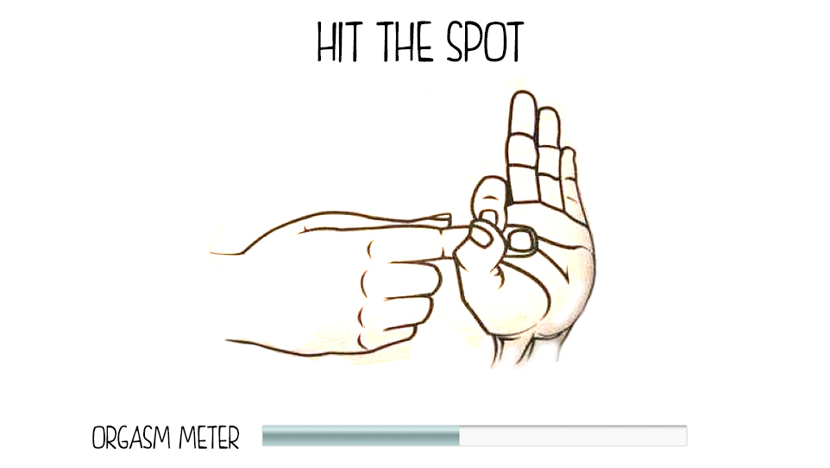
12. Hit The Spot microsite idea
This is a simple micro site idea, wherein we make a simple web based game
Fans will have to just click the space bar to move the left hand and fill the orgasm meter
The faster they hit the space bar the faster meter fills with an increasing noise of orgasm and the screen gets a splash of cum
After the screen clears the trailer flashes on the screen for the fans to view it
We can do a Mobile App version of this microsite too.

